Slide 1
Dimensionality Reduction & Clustering Reactions
Meeting 1 – May 12, 2023

Slide 2
Classification of Metabolic Reactions
Data Preprocessing:
Select subset of equidistant time points
Remove reactions with constant values over time
Eliminate transport and exchange reactions
Remove redundant reactions, keep one representative for coupled reactions
Clustering:
Group metabolic reactions based on flux values over time and samples
Use unsupervised machine learning techniques, such as clustering algorithms
Determine optimal number of clusters using predefined criteria
Random Forest Classifier:
Use flux-states resulting from clustering as labels
Train a Random Forest classifier to predict flux-state labels based on reactions
Ensemble learning method with multiple decision trees
Feature Importance:
Compute feature importance using Mean Decrease in Accuracy (MDA) metric
Measure importance of reactions in accurately predicting flux-states
Identify reactions with significant impact on differentiating flux-states

Slide 3
Alternative Methods
Alternative Methods to Consider:
Other techniques may be preferred over clustering and random forests in certain situations
Here are some reasons why alternative methods might be beneficial:
Interpretability:
Clustering alone may not reveal specific important reactions.
Random forests' interpretation is limited to the classifier's context.
Other methods (e.g., feature selection, interpretability-focused dimensionality reduction) provide clearer insights into specific reactions and their relevance.
Dimensionality Reduction:
High-dimensional datasets (e.g., hundreds or thousands of reactions) can benefit from dimensionality reduction.
Techniques like PCA, NMF, or Sparse PCA capture essential information while maintaining interpretability.
Reducing dimensionality addresses the curse of dimensionality, improves computational efficiency, and focuses on informative features.

Slide 4
Alternative Methods
3. Alternative ML Algorithms:
Explore other ML algorithms beyond random forests, such as SVM, gradient boosting, or deep learning.
Different algorithms have varying strengths and may yield better results for identifying relevant reactions.
4. Combination of Techniques:
Combining approaches can provide a comprehensive analysis.
Use clustering to identify initial patterns, then apply dimensionality reduction or feature selection within each cluster.
This hybrid approach leverages the strengths of different methods for a more comprehensive analysis.

Slide 5
Next Steps: Preserving interpretability while using PCA
Feature Selection:
Use tailored feature selection techniques (e.g., mutual information, L1 regularization, recursive feature elimination) to identify informative reactions for analysis (reduce noise, eliminate redundant or irrelevant features).
Retain interpretability of original metabolic reactions without relying on latent space representation.
Interpretability-Aware Dimensionality Reduction:
Explore techniques like NMF or Sparse PCA for dimensionality reduction while preserving interpretability.
Obtain reduced-dimensional representations that can be interpreted in terms of original metabolic reactions.
Integration of PCA with Feature Importance:
Apply feature selection techniques to the original set of reactions to identify informative features.
Perform dimensionality reduction using NMF or Sparse PCA on the selected features.
The reduced-dimensional representation will contain a subset of important reactions that are interpretable and relevant for analysis.
Analyze the reduced-dimensional data to gain insights into the relationships and dynamics of metabolic reactions.

Slide 6
Dimensionality Reduction & Clustering Reactions
Meeting 2 – May 22, 2023 (Cancelled)

Slide 7
Data Pre-Processing & Feature Selection
Preprocessing:
Select subset of equidistant time points: To select a subset of time points, you can define a fixed interval and choose representative time points within that interval. For example, you can select every nth time point or evenly spaced time points.
Remove reactions with constant values over time: Identify reactions that have the same value across all time points and remove them from the dataset. These reactions do not contribute to the variability and can be considered constant.
Eliminate transport and exchange reactions: Transport and exchange reactions often have consistent and uninformative patterns across different samples. Removing them can help focus on reactions with more meaningful variations. You can identify these reactions based on specific identifiers or patterns in their names or annotations.
Remove redundant reactions, keep one representative for coupled reactions: If you have reactions that are highly correlated or coupled, you can remove redundant reactions and keep one representative. This can reduce the redundancy in your data and improve computational efficiency.

Slide 8
Data Pre-Processing & Feature Selection
Feature Selection: When working with sparse matrices, traditional feature selection methods like filter methods (e.g., mutual information, correlation) may still be applicable. However, they might not fully leverage the sparsity of the data. Consider the following options:
Sparse feature selection methods: Look for feature selection techniques specifically designed for sparse data, such as L1 regularization (Lasso) or sparse linear regression. These methods encourage sparsity in the selected features and can effectively handle sparse matrices.
Univariate feature selection: Use univariate statistical tests (e.g., chi-square test, ANOVA) to evaluate the relationship between each feature and the target variable. Select features with significant p-values or high scores as they are more likely to be informative.
Feature selection with dimensionality reduction techniques: Instead of performing feature selection separately, you can combine it with dimensionality reduction methods like PCA. Some variants of PCA, such as sparse PCA or regularized PCA, can directly incorporate feature selection into the dimensionality reduction process.

Slide 9
PCA
Dimensionality Reduction (PCA): PCA can still be a good option for dimensionality reduction, even with sparse matrices. However, traditional PCA may not fully exploit the sparsity of the data. Consider the following suggestions:
Sparse PCA: Look for sparse PCA implementations that are specifically designed for sparse data. Sparse PCA methods consider the sparsity of the data and aim to find sparse representations of the original features.
Randomized PCA: Randomized PCA is an approximation algorithm that can speed up the computation of PCA for large sparse datasets. It provides a close approximation to the principal components while reducing computational complexity.
Incremental PCA: Incremental PCA is useful when memory is a constraint. It processes the data in batches, allowing you to perform PCA on large sparse datasets without loading the entire dataset into memory.

Slide 10
Process
Overall Process: Here's a suggested workflow that incorporates preprocessing, feature selection, and PCA:
Preprocess the data: Select subset of equidistant time points, remove reactions with constant values, eliminate transport and exchange reactions, and remove redundant reactions.
Perform feature selection: Apply appropriate feature selection methods, considering the sparsity of the data. Use sparse feature selection techniques or combine feature selection with dimensionality reduction methods like PCA.
Apply dimensionality reduction (PCA): Use PCA or its variants, such as sparse PCA or randomized PCA, to reduce the dimensionality of the selected features. Consider memory-efficient algorithms like incremental PCA if memory is a concern.
Analyze the results: Evaluate the loadings and contributions of the features in the reduced-dimensional space. Rank and interpret the important reactions based on their weights or loadings.

Slide 11
Speeding up process
When working with large and sparse matrices, the preprocessing, feature selection, and PCA steps can be computationally intensive. Here are some suggestions to speed up the process:
Parallelization: Utilize parallel computing techniques to distribute the computations across multiple cores or machines. This can significantly reduce the processing time, especially when dealing with large datasets. Libraries like joblib or dask provide convenient tools for parallelization.
Sparse matrix operations: Take advantage of sparse matrix operations and algorithms specifically designed for sparse data. Sparse matrix representations and optimized algorithms can speed up computations and reduce memory requirements. Make sure to use libraries that support sparse matrix operations, such as scipy.sparse or scikit-learn for PCA with sparse data.

Slide 12
Speeding up process
Dimensionality reduction with truncated SVD: Instead of using traditional PCA, consider using truncated SVD (Singular Value Decomposition) for dimensionality reduction. Truncated SVD is particularly efficient for sparse matrices and can provide similar results to PCA. Libraries like scikit-learn provide implementations of truncated SVD.
Remember to evaluate the trade-off between computation time and the level of approximation or accuracy required for your specific analysis. Adjust the parameters and techniques accordingly to balance speed and quality of results.
By incorporating these strategies, you can speed up the preprocessing, feature selection, and PCA steps for large and sparse matrices, making the analysis more efficient and manageable.

Slide 13
Dimensionality Reduction on dFBA
Meeting 3 – June 6, 2023

Slide 14
PCA
Time series data has temporal dependencies, which violate the independence assumption of PCA.
PCA does not account for the sequential nature of time series data, leading to inaccurate representation of dynamics.
PCA may not capture relevant temporal patterns and interactions between reactions.
Dimensionality reduction with PCA can result in loss of important information related to temporal dynamics.
Explore alternative techniques designed for time series analysis or feature selection approaches to better preserve temporal dynamics and capture important features.

Slide 15
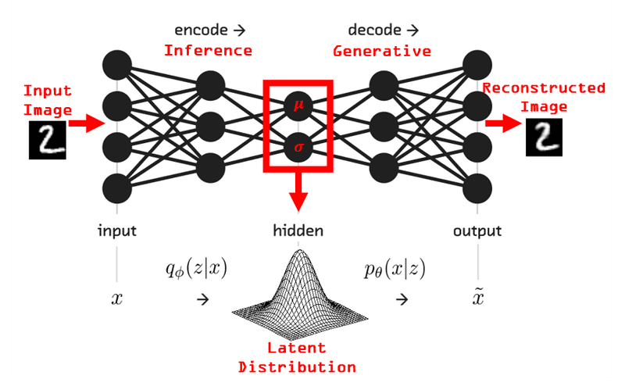
Autoencoders
Autoencoders: Neural network models for unsupervised learning and dimensionality reduction.
Purpose: Learn efficient data representations by compressing input into a latent space and reconstructing it.
Architecture: Encoder compresses input, decoder reconstructs it from the latent representation.
Training: Minimize reconstruction error between original and reconstructed data.
Key Idea: Autoencoders capture salient features, extracting meaningful representations.
Applications: Dimensionality reduction, anomaly detection, data denoising, and synthetic data generation.

Slide 16
Autoencoder Benefits
Dimensionality Reduction:
reduce data dimensionality while preserving important features
Unsupervised Learning:
learn data structure without labeled data
Anomaly Detection:
identify anomalies by comparing reconstructed data to originals
Feature Extraction:
learn informative feature representations for downstream tasks
Data Generation:
generate new data samples from the learned latent space

Slide 17
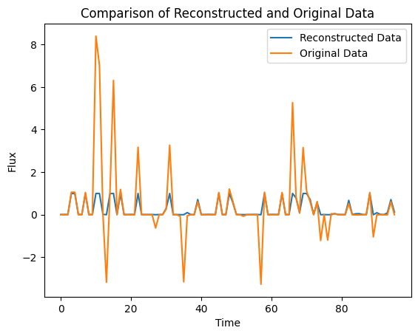
Results (working)

Slide 18
Improving Autoencoder Reconstruction
Increase model complexity:
Add more layers or neurons
Adjust activation functions
Train for more epochs:
Increase the number of training iterations
Adjust hyperparameters:
Experiment with learning rate, batch size, optimizer
Normalize or preprocess the data:
Apply scaling or normalization techniques
Try different architectures:
Explore recurrent autoencoders

Slide 19
Next
Run autoencoder on subset of data, optimize model architecture
How to use HPC

Slide 20
Dimensionality Reduction on dFBA
Meeting 3 – June 19, 2023

Slide 21
Dimensionality Reduction on dFBA
Meeting 4 – July 10, 2023

Slide 22
Update
Filtering reactions:
Select subset of equidistant time points
Remove reactions with constant values over time
Eliminate transport and exchange reactions
Remove redundant reactions, keep one representative for coupled reactions
Check if PCA can be run at each time step
Use test train and validation dataset for autoencoder data
Check meaningfulness of latent space by using reg or knn
Use loss, integration between curves over all fluxes and use this perhaps for hyperparameter (need metric for loss)

Slide 23
Update
Updated with 3D matrix (3754 x 15 x 95) with 15 cell lifelines (ran on personal computer)
Working
Add layers but memory problems
Increasing training epochs and trials
Adjust hyperparameter search space
Run for more lifelines
Latent space representation
Time steps can skip
LSTM
Goal – reduce number of reaction fluxes
Improve this latent space
Try biomass reaction

Slide 24
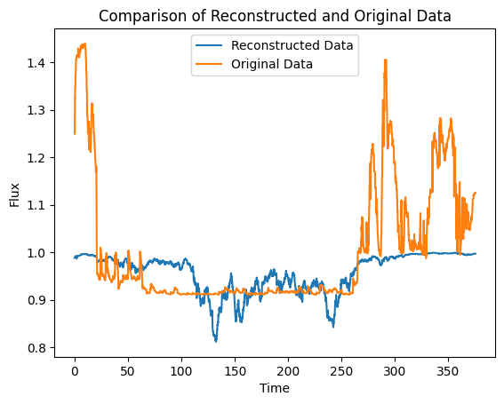
Example Results
Best Hyperparameters: {'hidden_units': 17, 'latent_units': 34, 'activation': 'relu', 'learning_rate': 0.000506829711966478} Best Loss: 1.9310521729525925

Slide 25
Project Overview
Meeting 5 – September 25

Slide 26
Project Scope
Project Focus
Study cell behavior in a high substrate variability industrial bioreactor
Analyze internal cell data: substrate concentration, uptake rate, metabolic analysis, and fluxes
Objective 1: Problems to Solve
Extract relevant information from internal cell data
Reduce dataset size if possible
Analyze single cell and group trends
Define meaningful metabolic states and reactions
Explore innovative data representation

Slide 27
Relevant Literature
Autoencoders Based Dimensionality Reduction
Effectively capture complex data structures & compress information
# of hidden layer nodes influences performance > data dimensionality
A Folded Neural Network Autoencoder
Reduces computational complexity and surpasses PCA
Promising for handling high-dimensional data
Autoencoder-based Deep Learning for Time Series Clustering
Combining K-means with autoencoders in a two-stage approach achieves high accuracy in time series data clustering
Deep learning models uncover hidden features, leading to improved clustering performance
Notes:
Autoencoders Based Dimensionality Reduction
Autoencoders effectively capture complex data structures and compress information
The number of hidden layer nodes influences performance, revealing a connection to data dimensionality
Autoencoders have potential as foundational components in deep learning architectures
A Folded Neural Network Autoencoder
The folded autoencoder reduces computational complexity and surpasses PCA while matching conventional autoencoders' performance
Promising for handling high-dimensional data and enhancing dimensionality reduction
Autoencoder-based Deep Learning for Time Series Clustering
Combining K-means with autoencoders in a two-stage approach achieves high accuracy in time series data clustering
Deep learning models uncover hidden features, leading to improved clustering performance

Slide 28
Methodology
Transforming Lifelines to Internal Cell Data
Process: Transforming 150,000 lifelines into internal cell data
Data Elements: Time series substrate concentration, substrate uptake rate (qS), dFBA, internal fluxes
Objective 1 - Data Analysis with Autoencoders
Autoencoders: Neural networks for unsupervised learning and dimensionality reduction
Architecture: Encoder compresses data into a latent space, decoder reconstructs it
Purpose: Extract meaningful features and patterns from internal cell data
Application: Analyzing, visualizing, and reducing complexity of the data

Slide 29
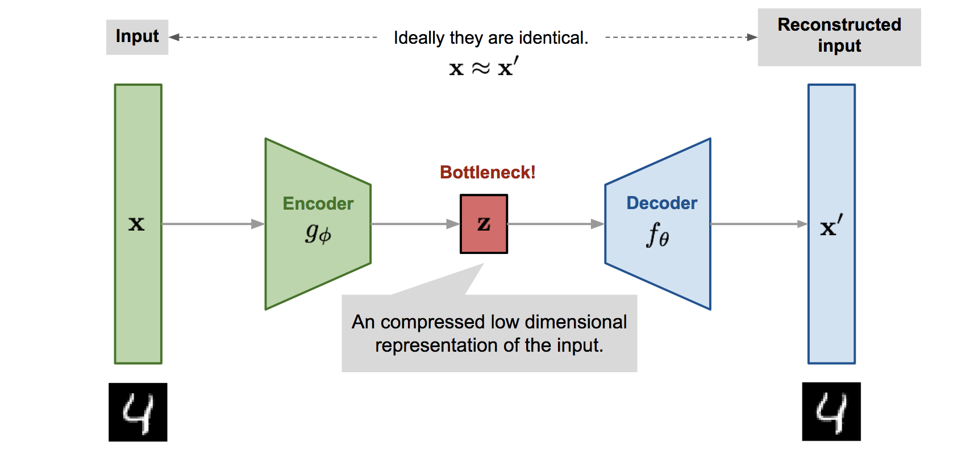
Autoencoders

Slide 30
Methodology
Exploring Data Reduction and Innovative Representation
Autoencoders for Dataset Reduction: Use LSTM autoencoders to reduce data complexity
Tackling Dimensionality: Address limitations of traditional methods like PCA
Identifying Relevant Features: Extracting informative insights while preserving temporal characteristics
Analyzing Lifeline Trends and Lifeline Groups
Analyzing Single Cell Lifeline: Using time series analysis, clustering, and classification
Identifying Similarities and Trends: Reveal patterns and cycles within reactor lifelines

Slide 31

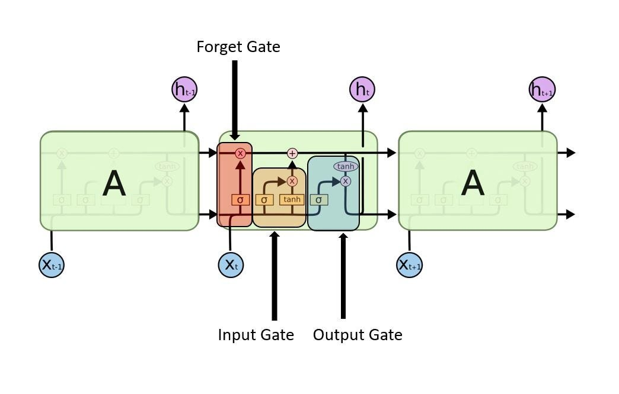
RNNs & LSTMs

Slide 32
Methodology
Determining Metabolic States and Reactions
Clustering Metabolic States: Employing various clustering techniques for reaction flux data
Innovative Data Representation
Visualization with t-SNE: Mapping latent space for insight into data structure
Learning Manifolds with Autoencoders: Capturing and modeling data manifold structures

Slide 33
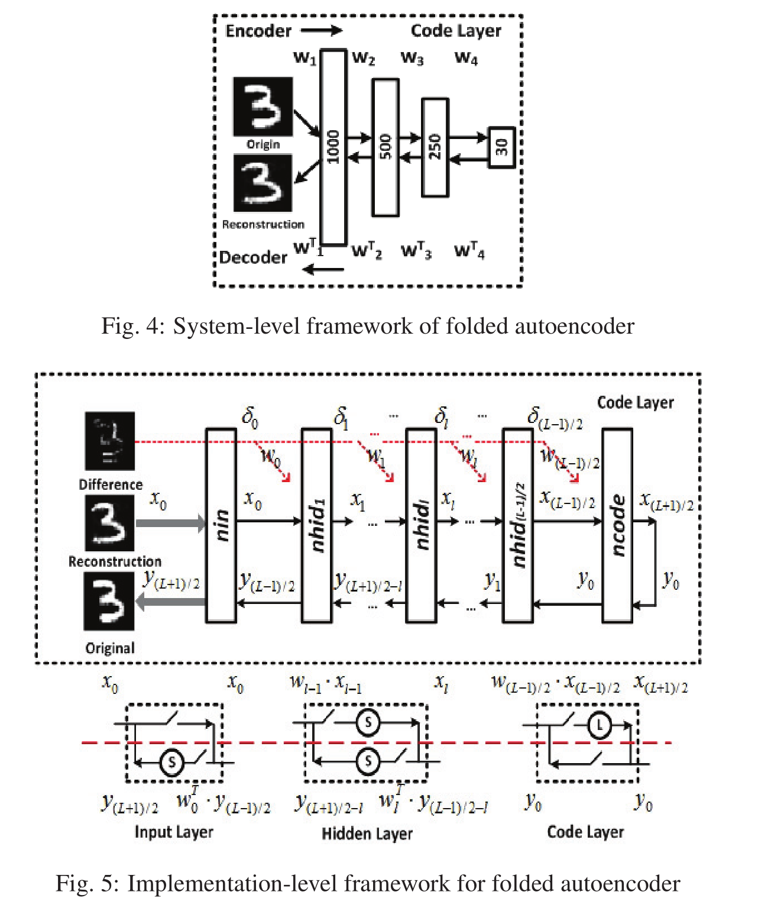
Innovative Strategies & Ideas
Folded Autoencoder Structure:
Utilize folded autoencoder for optimized dimensionality reduction
Benefits: reduces weights, enhances performance, and lowers computational costs through symmetry
Regularized Autoencoders:
Employ regularized autoencoders for enhanced model capabilities
Use distinct loss functions for emphasizing sparsity, minimizing representation derivatives, and handling noisy or incomplete inputs for more effective data extraction

Slide 34
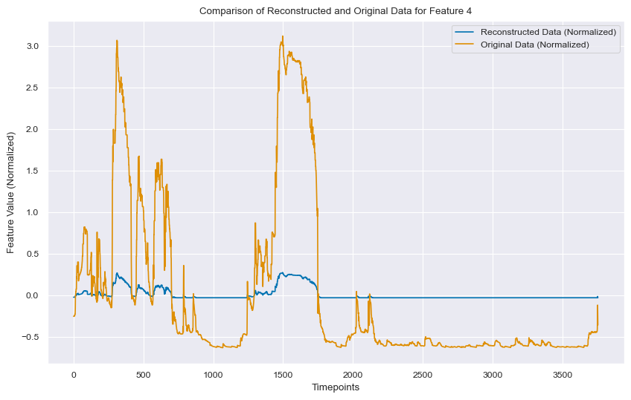
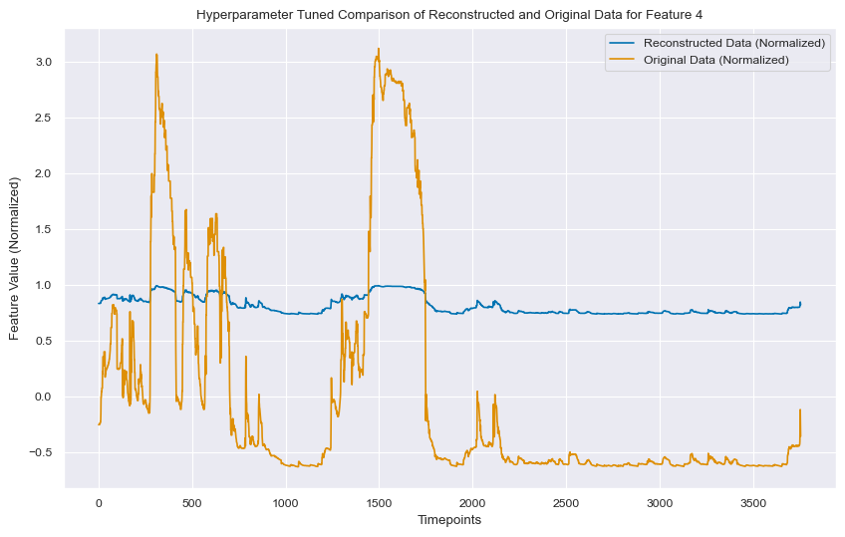
Initial Results
Best Hyperparameters: {'lstm_units': 56, 'latent_units': 7, 'batch_size': 16, 'activation_fn': 'tanh', 'learning_rate': 6.332406429519958e-05}

Slide 35
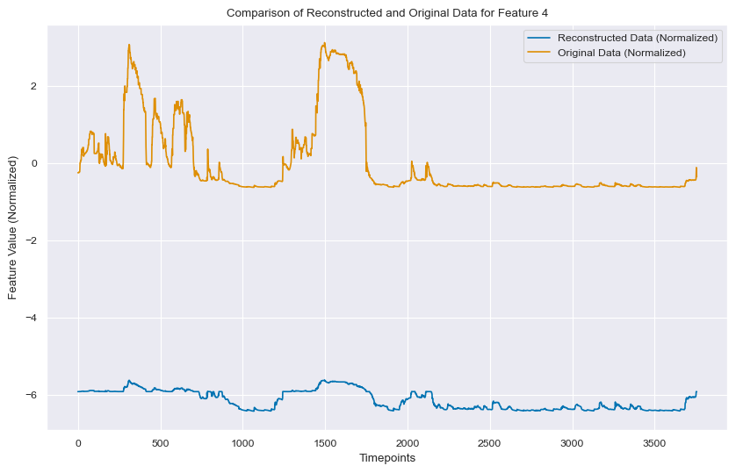
Initial Results with Drop Out + Batch Normalization
Best Hyperparameters: {'lstm_units': 84, 'latent_units': 48, 'batch_size': 32, 'activation_fn': 'tanh', 'learning_rate': 0.0001607963329695215, 'dropout_rate': 0.4364263847969744}

Slide 36
Comparison between models
Meeting 6 – October 10

Slide 37
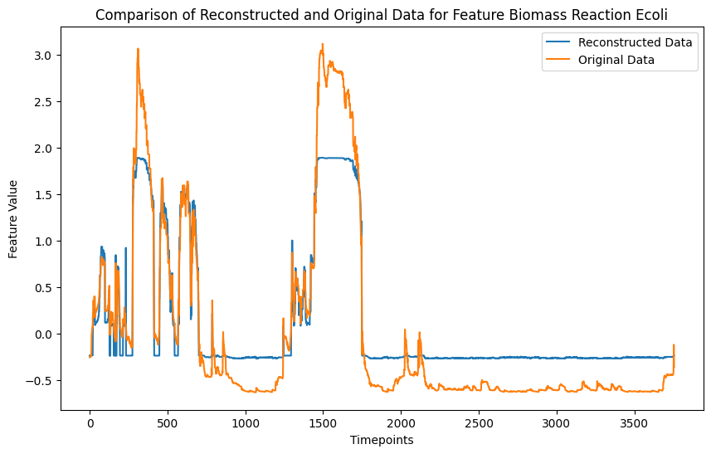
Autoencoder Initial Results (Biomass Reaction)

Slide 38
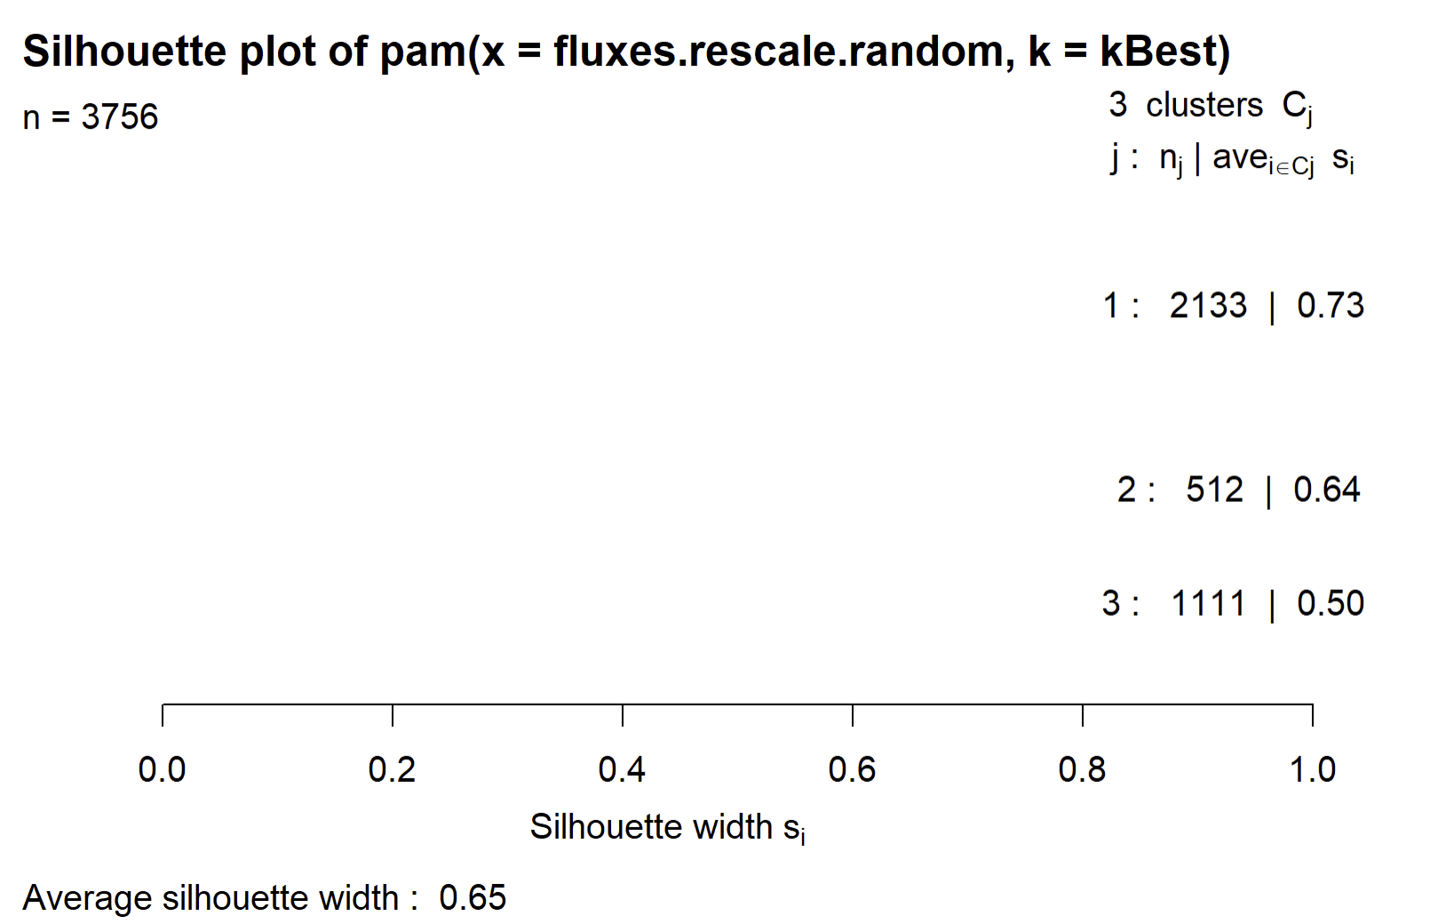
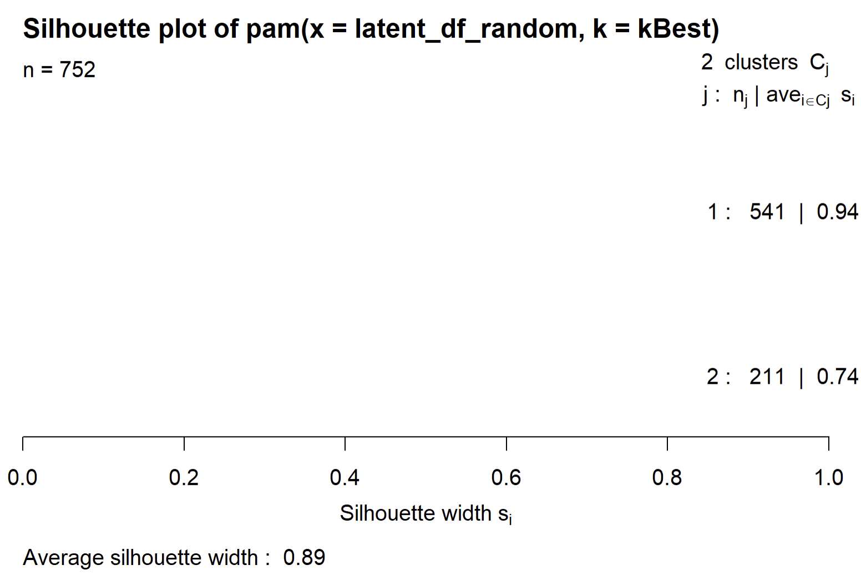
Comparison Silhouette Score
Silhouette Score Overview:
Range: -1 (poor) to 1 (excellent)
Measures similarity within cluster vs. between clusters
Results:
Without dimensionality reduction: 0.65
With dimensionality reduction: 0.89
Interpretation:
Dimensionality reduction captures intrinsic data structure
Leads to more distinct and accurate clustering
Reduced data provides clearer underlying patterns

Slide 39
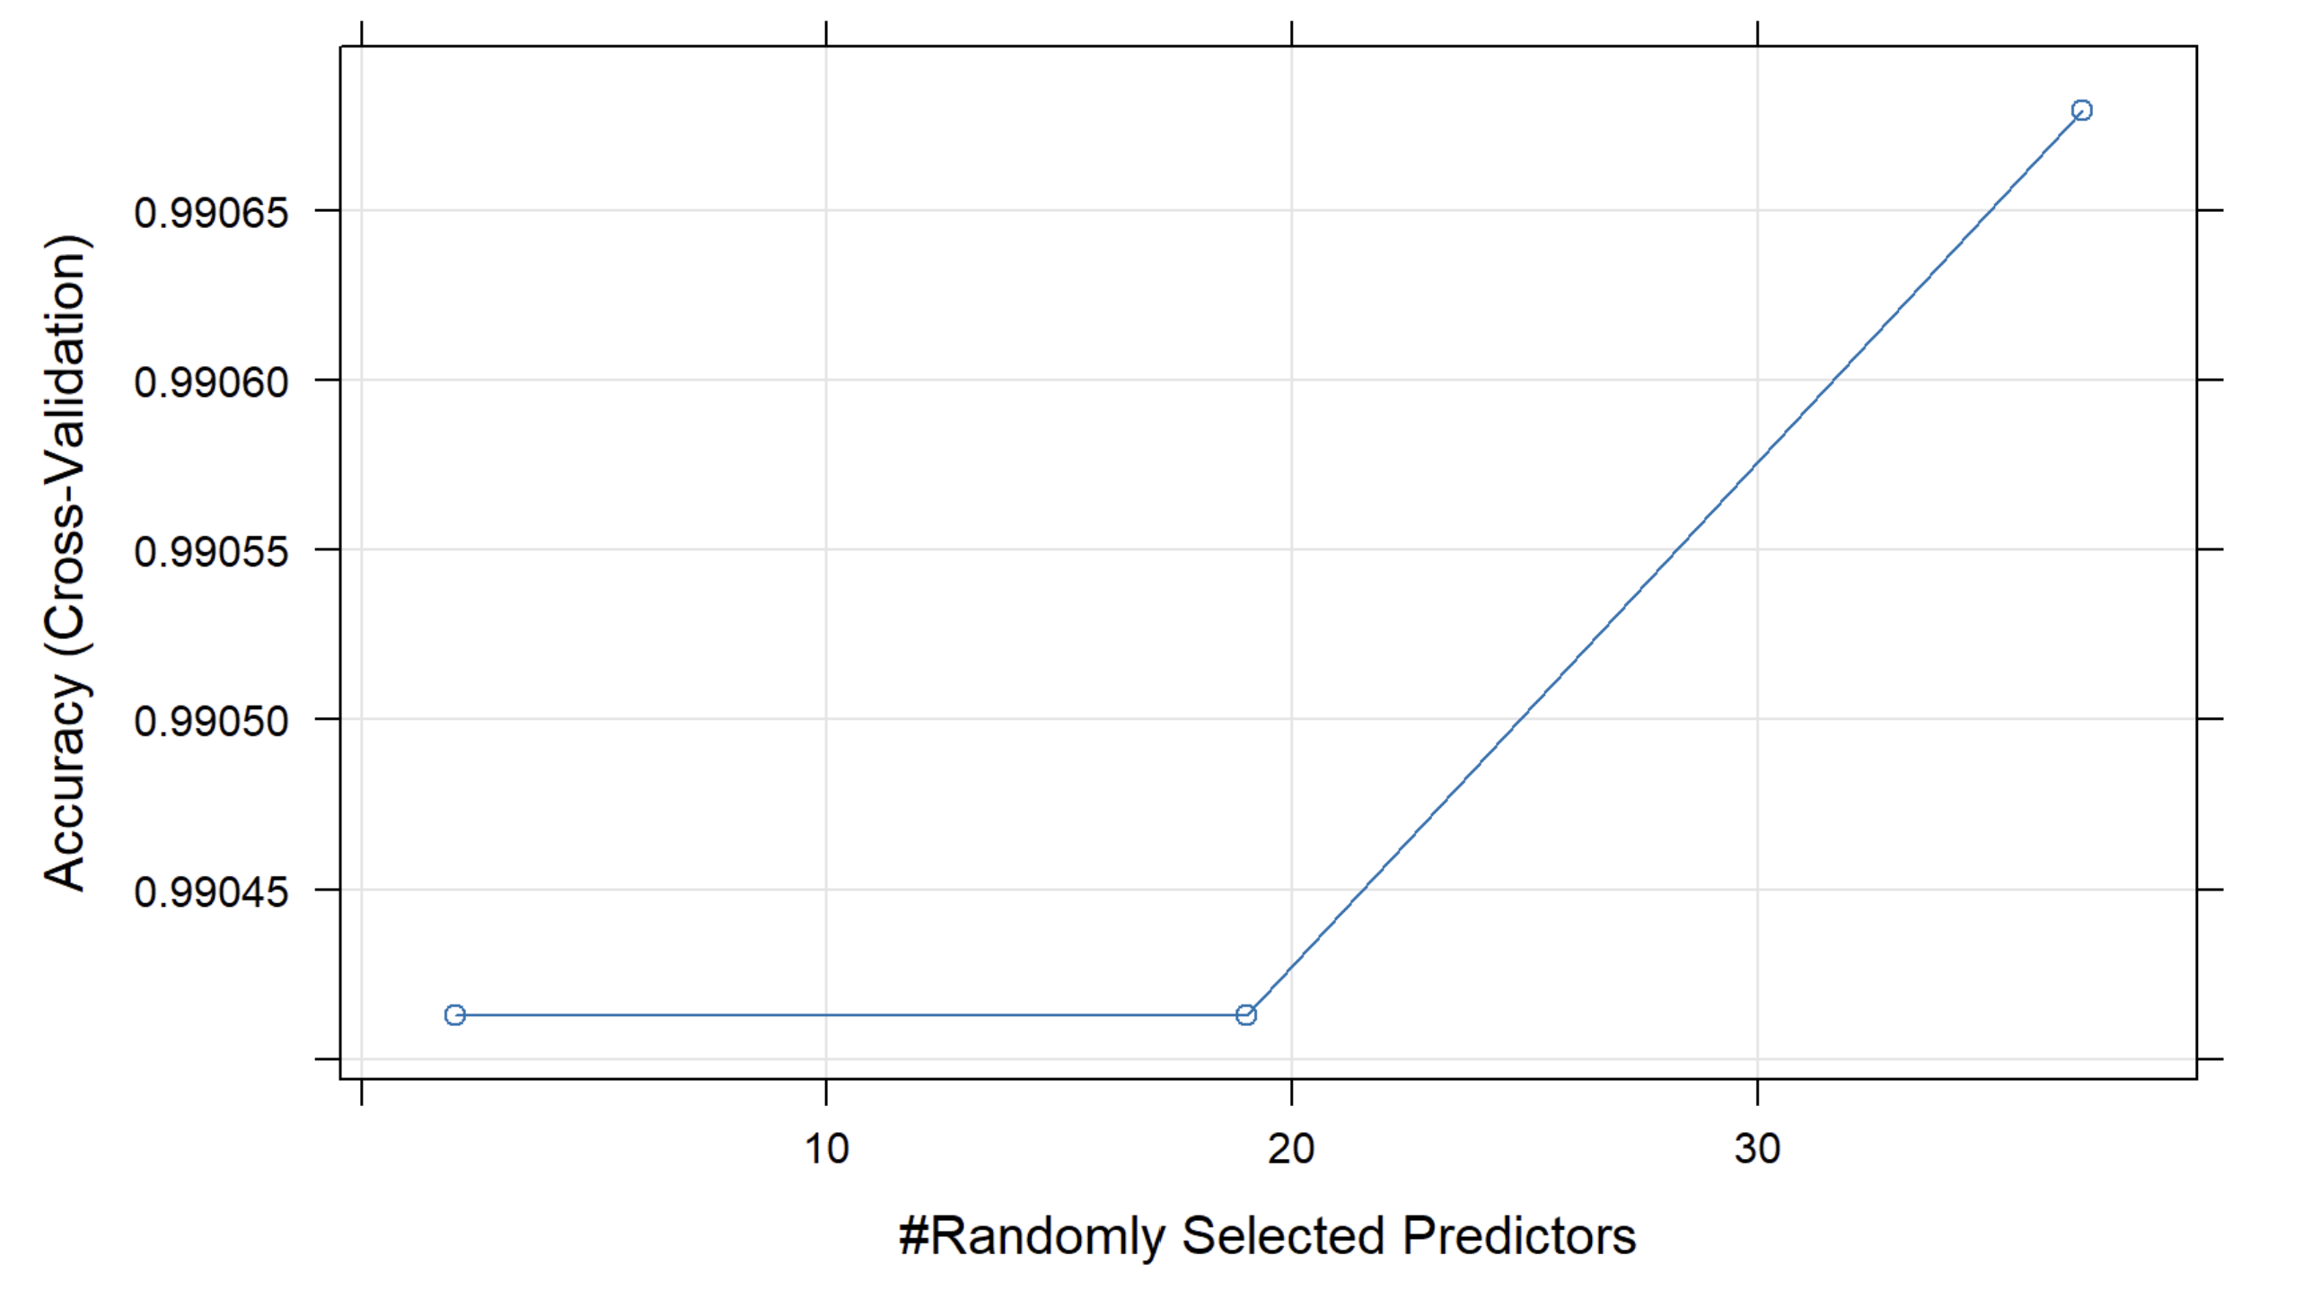
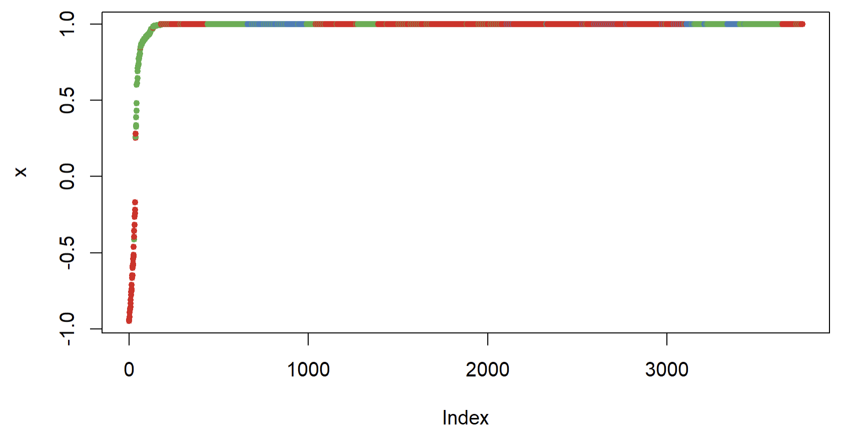
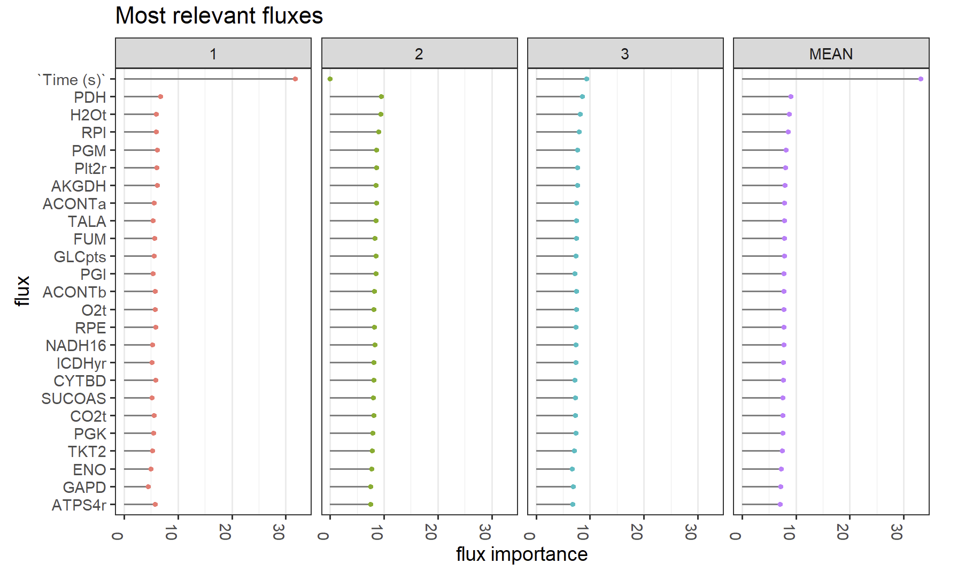
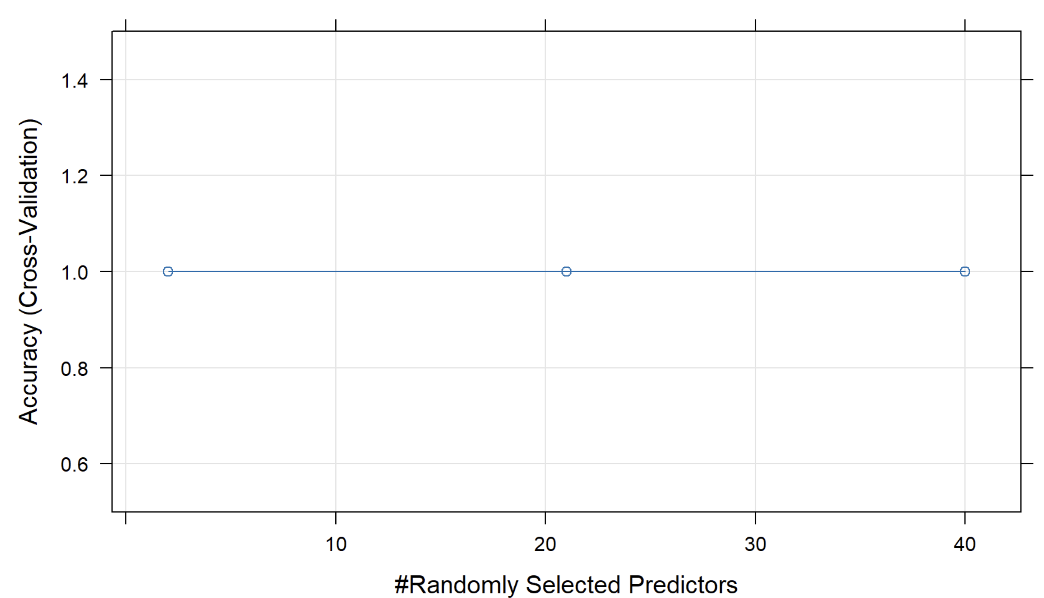
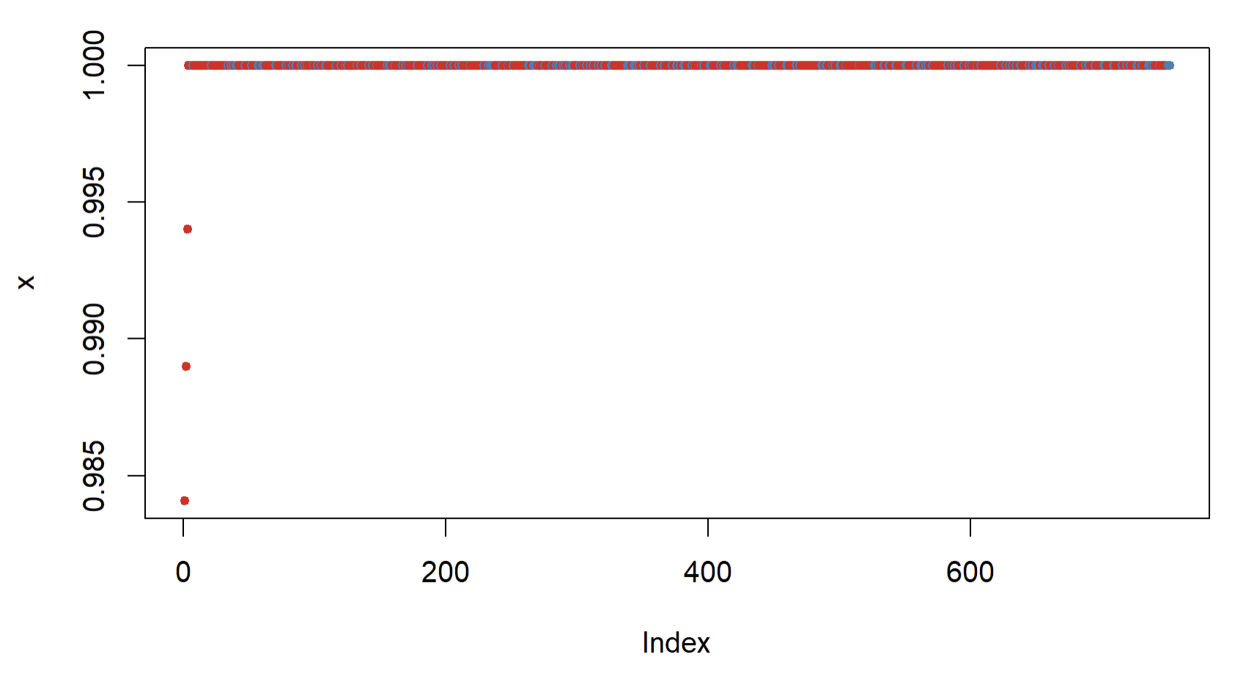
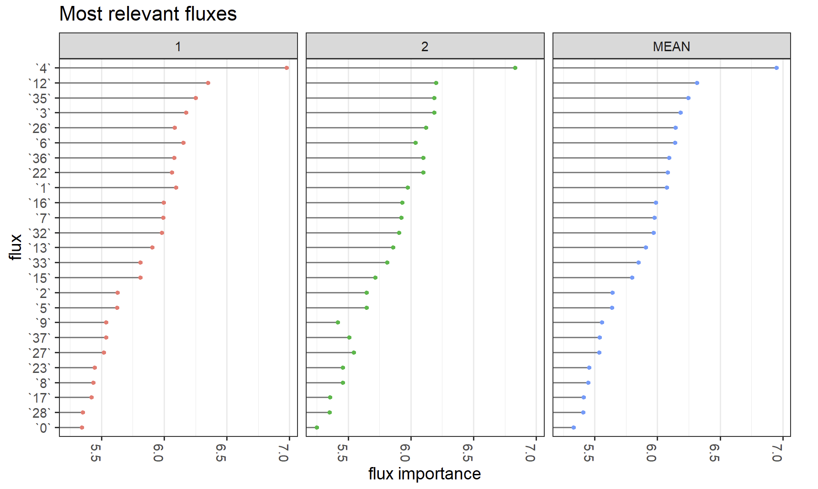
Comparison of Random Forest Classification

Slide 40
Benefits of AE Dimensionality Reduction
Enhanced Silhouette Scores: Clearer, better-defined clusters
Temporal Dependencies: Recognizes patterns in sequential data.
Non-linear Relationships: Captures complex feature interactions.
Noise Reduction: Cleaner data representation.
Optimized Classification: Potential for more accurate results.
Efficient Data Handling: Retains vital information with reduced size.
Notes:
Improved Silhouette Scores:
Dimensionality reduction led to enhanced cluster quality, evident from higher silhouette scores.
Captures Temporal Dependencies:
Autoencoders are adept at recognizing temporal patterns in sequential data.
Handles Non-linear Relationships:
Autoencoders can capture intricate non-linear relationships between features, enhancing data representation.
Noise Reduction:
Autoencoders help in denoising data, resulting in cleaner, more meaningful clusters.
Potential for Better Classification:
With a more compact and informative representation of data, classifiers can achieve better performance.
Efficient Data Representation:
Reduces data size while retaining critical information, making subsequent analyses computationally more efficient.

Slide 41
Notes / Next
Evaluate inertia for clustering
Random forest without time variable (for non reduced one)
Scaling up more lifelines
Visualize with cluster random forest PCA
(Later) Can you see metabolic states changing through time ?

Slide 42
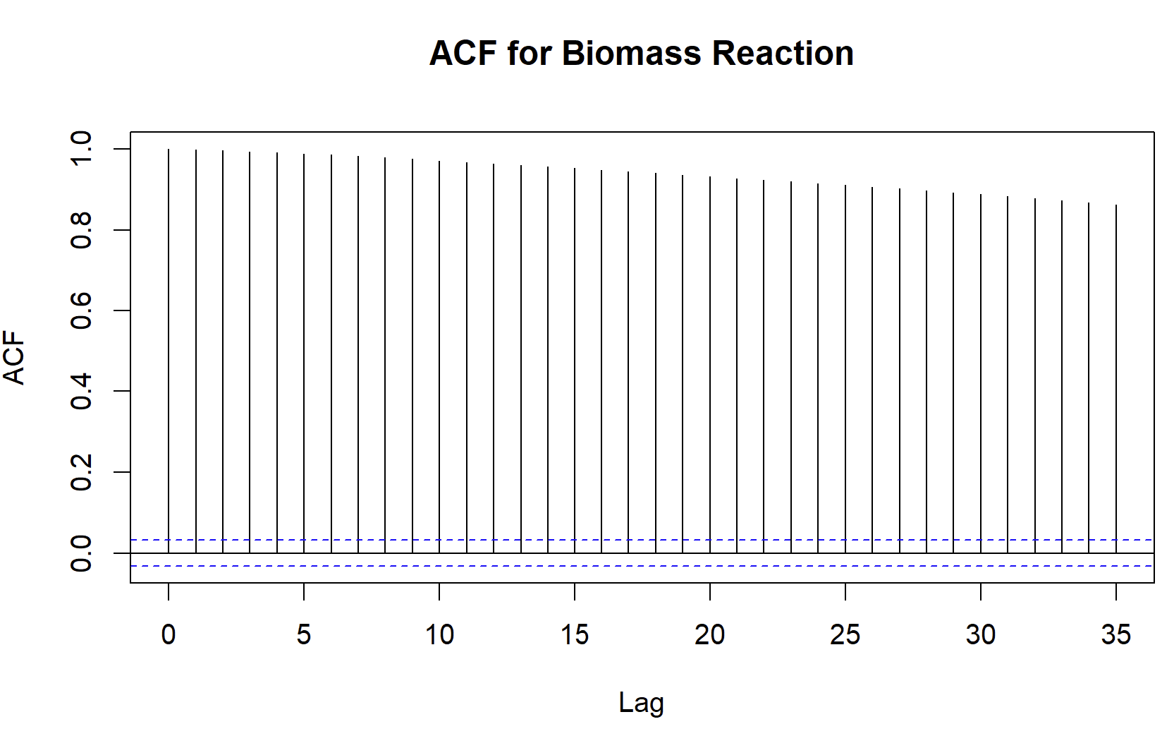
Autocorrelation Plot for Biomass Reaction

Slide 43
Comparison between models
Meeting 7 – October

Slide 44
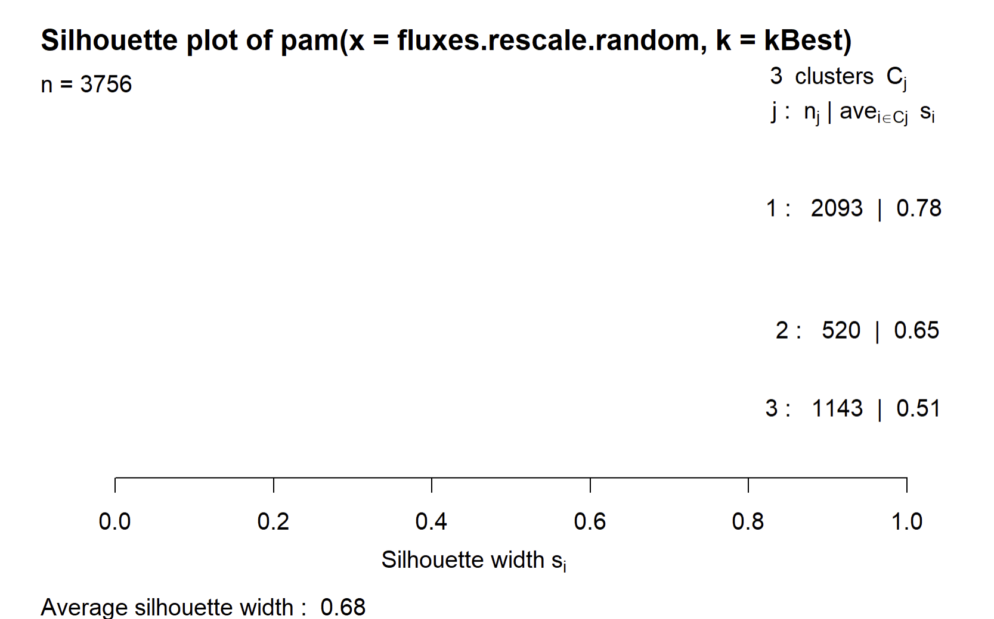
Comparison Silhouette Score
Silhouette Score Overview:
Range: -1 (poor) to 1 (excellent)
Measures similarity within cluster vs. between clusters
Results:
Without dimensionality reduction: 0.65 0.68
With dimensionality reduction: 0.89
Interpretation:
Dimensionality reduction captures intrinsic data structure
Leads to more distinct and accurate clustering
Reduced data provides clearer underlying patterns

Slide 45
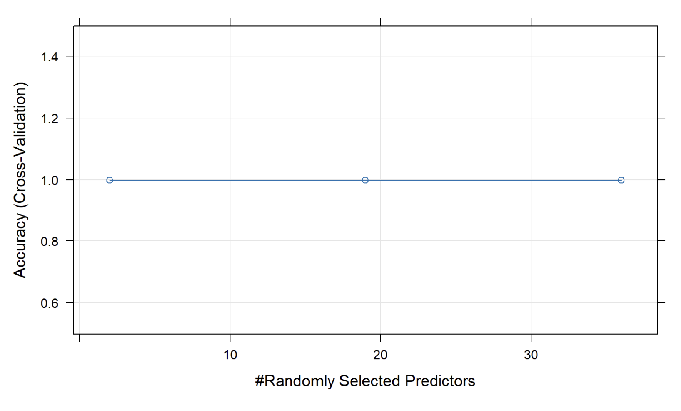
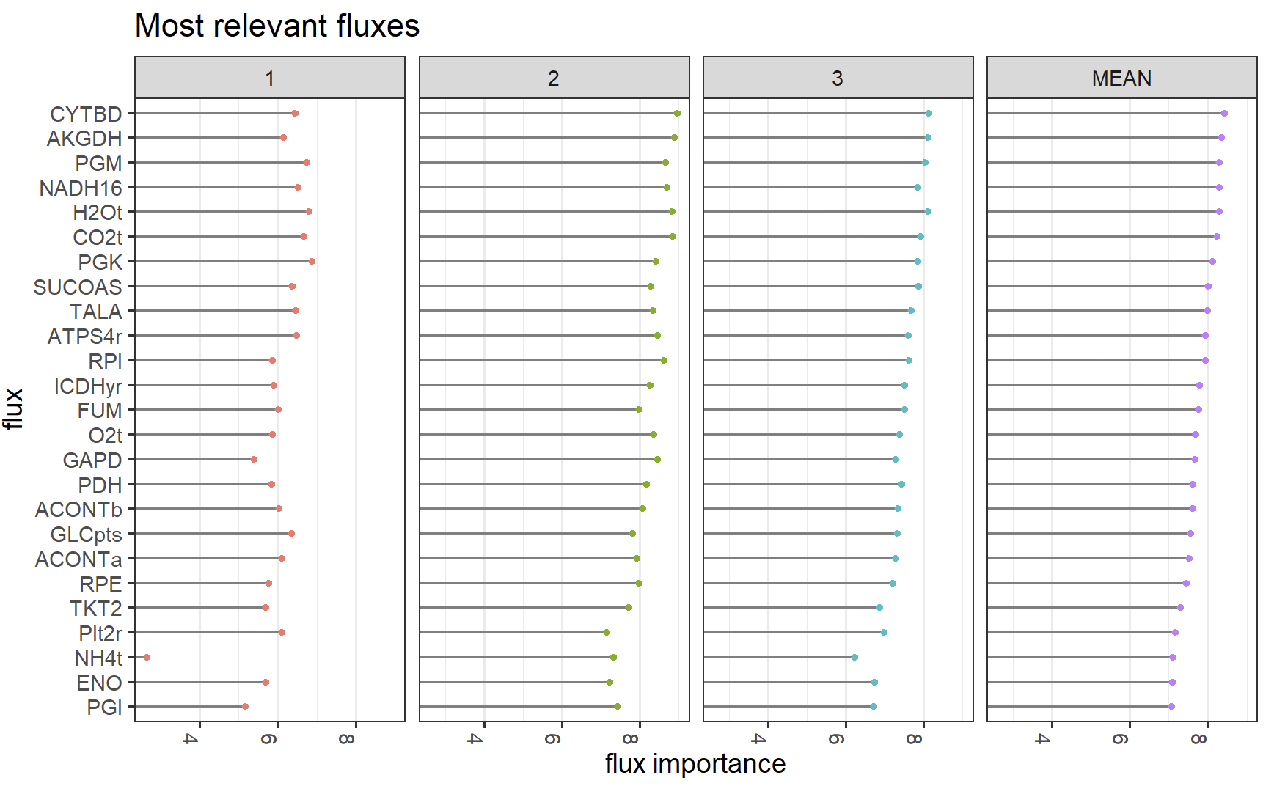
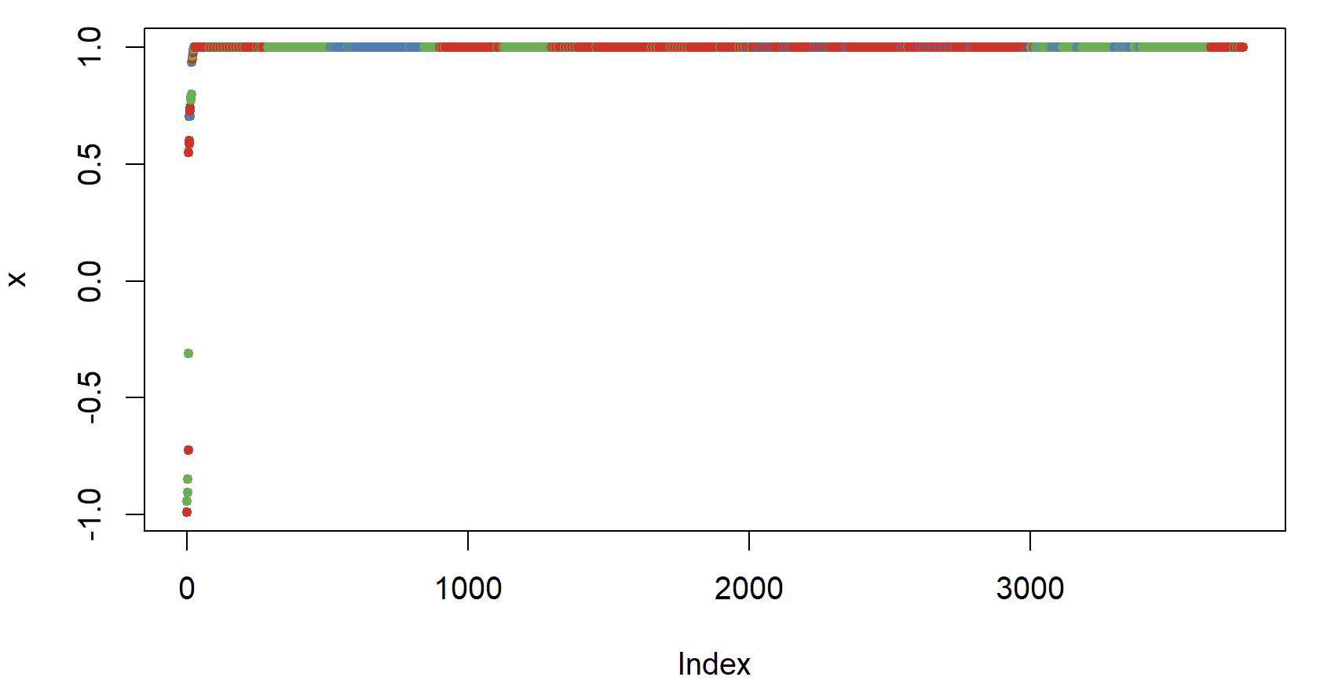
Comparison of Random Forest Classification

Slide 46
Updates
Evaluate inertia for clustering
Random forest without time variable (for non reduced one)
Scaling up more lifelines
Visualize with cluster random forest PCA
(Later) Can you see metabolic states changing through time ?

Slide 47
Scaling Up
Meeting 8 – Nov

Slide 48
Updates
Evaluate inertia for clustering
Random forest without time variable (for non reduced one)
Scaling up more lifelines (14 lifelines next slide)
Visualize with cluster random forest PCA
(Later) Can you see metabolic states changing through time ?

Slide 49
Comparison Silhouette Score
Silhouette Score Overview:
Range: -1 (poor) to 1 (excellent)
Measures similarity within cluster vs. between clusters
Results:
Without dimensionality reduction: 0.65 0.68
With dimensionality reduction: 0.89
Interpretation:
Dimensionality reduction captures intrinsic data structure
Leads to more distinct and accurate clustering
Reduced data provides clearer underlying patterns

Slide 50
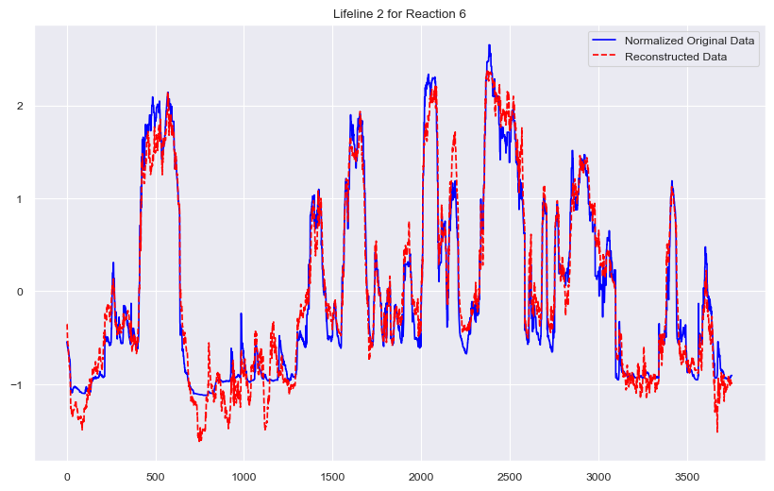
Scaling up – 14 lifelines reconstruction results
Best Hyperparameters: {'hidden_units': 17, 'latent_units': 34, 'activation': 'tanh', 'learning_rate': 0.0027572975779302763} Best Loss: 0.9821244168898637

Slide 51
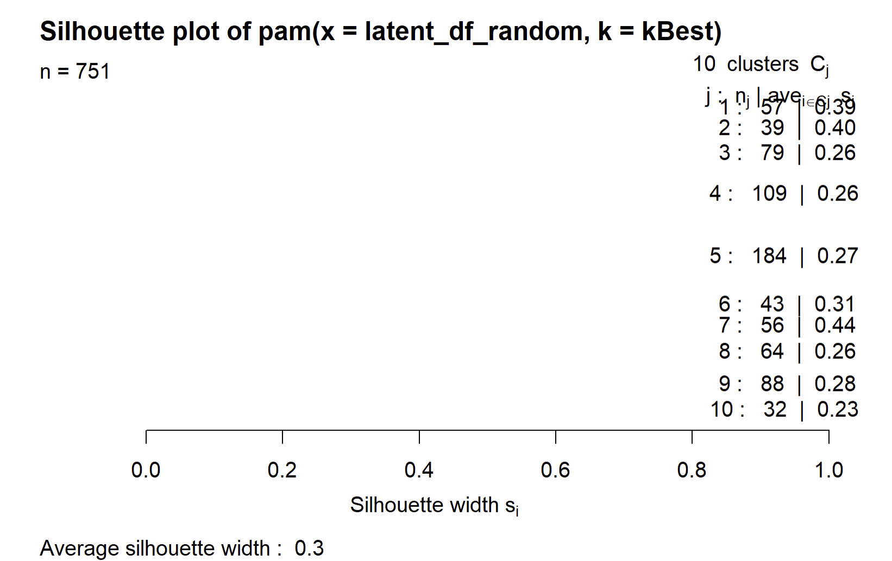
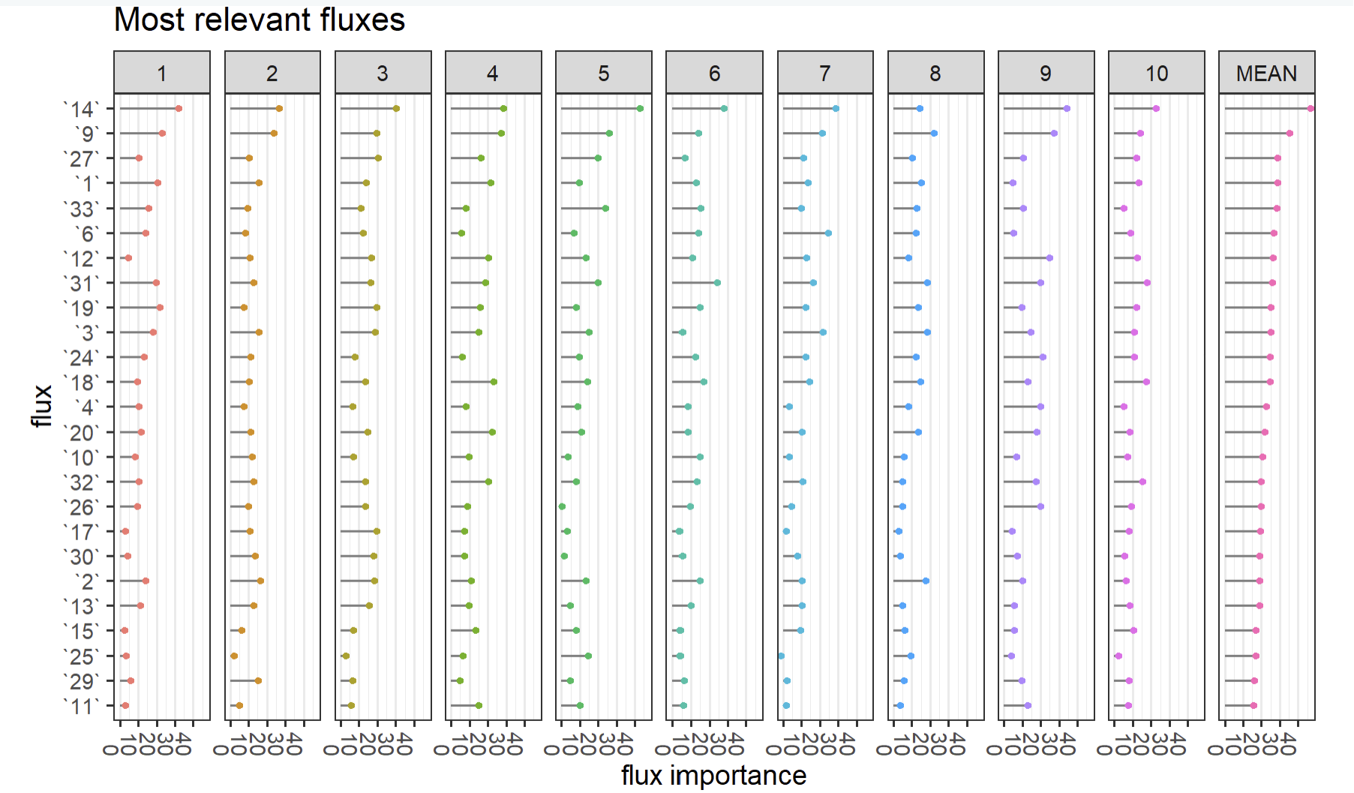
Working – 14 lifelines in Clustering + Random Forest
Issues:
Inertia: 2916.73
Reasonable amount of clusters (20 clusters -> 0.34, 50 clusters -> 0.43)
Interpretation ?

Slide 52
Next / working
HPC (how to estimate cores etc.) ?
Need more lifelines
Working on interpretation link of latent space <-> original features
Feature mapping (examining weight’s of autoencoder’s encoder)
Reconstruction analysis (seeing which reconstructed points vary the most and what clusters they are in)
Prototype analysis (for each cluster, map medoid using decoder back to original feature space)
Latent space visualization (t-SNE and UMAP)

Slide 53
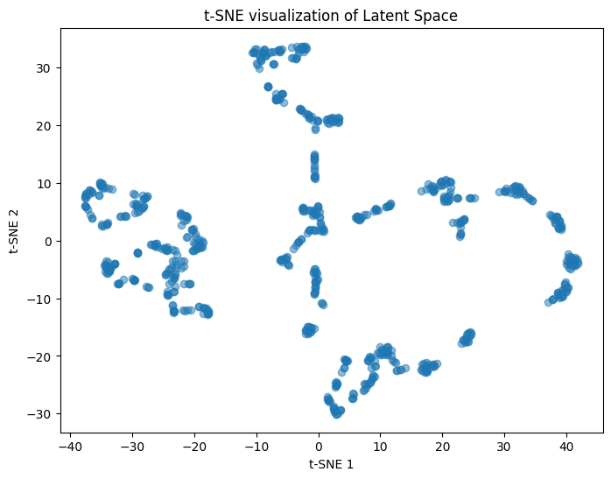
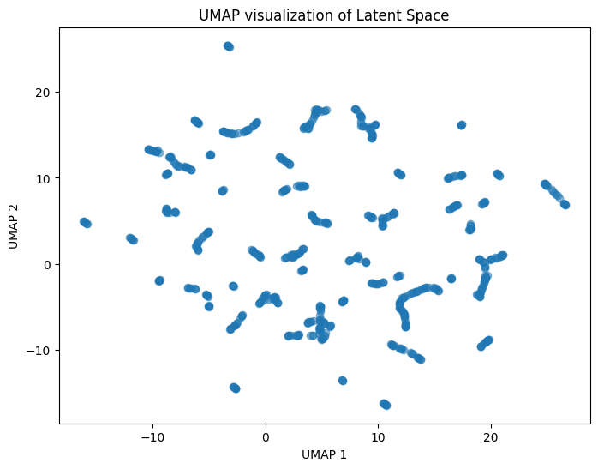
Latent Space Visualization

Slide 54
Batches = Lifelines
Meeting 10 – Feb 6, 2024

Slide 55
Updates
Adjusted structure so (n_lifelines, n_timesteps, n_features) is fed into AE
(14 lifelines, 376 timesteps, 48 features)
Tested with 1, 14, and 100 lifelines, overfits as expected for AE
Latent representation:
One vector for each lifeline (dimensions is 1 x 40, 40 neurons in latent space layer)
Therefore, latent representation file has 14 vectors
Visualized with clusters (PCA)

Slide 56
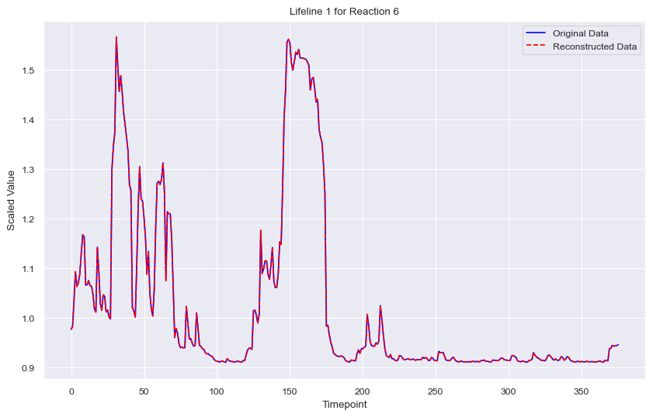
One Lifeline

Slide 57
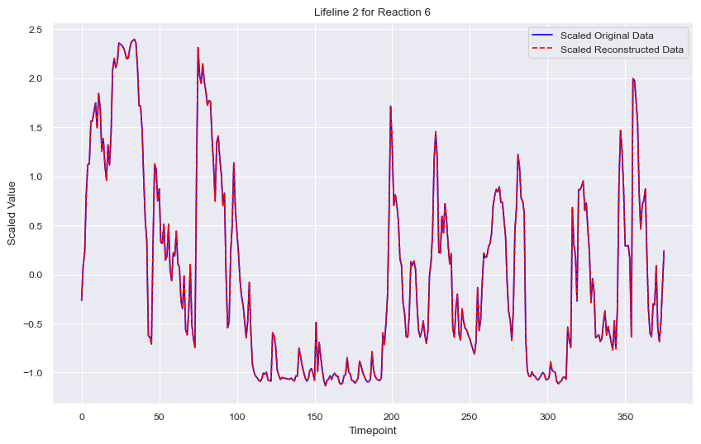
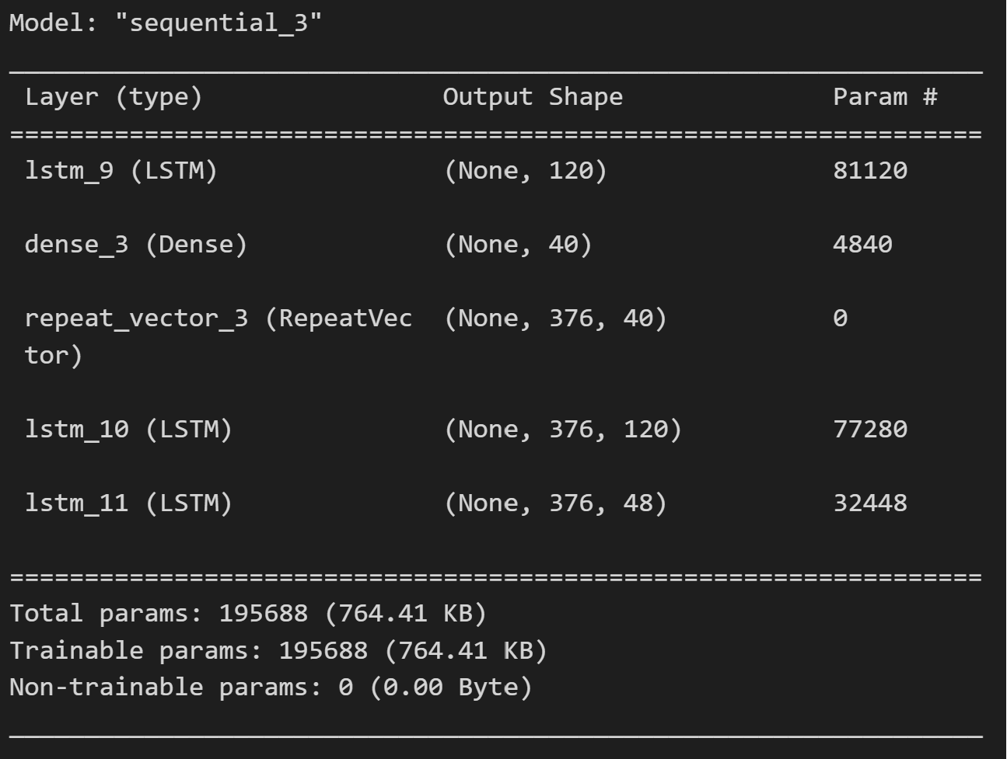
14 Lifelines

Slide 58
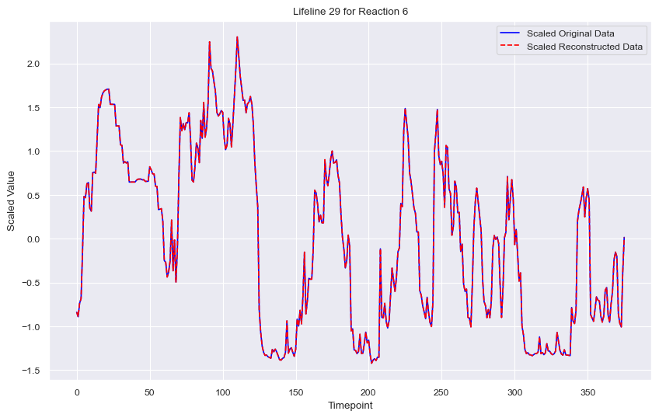
100 Lifelines

Slide 59
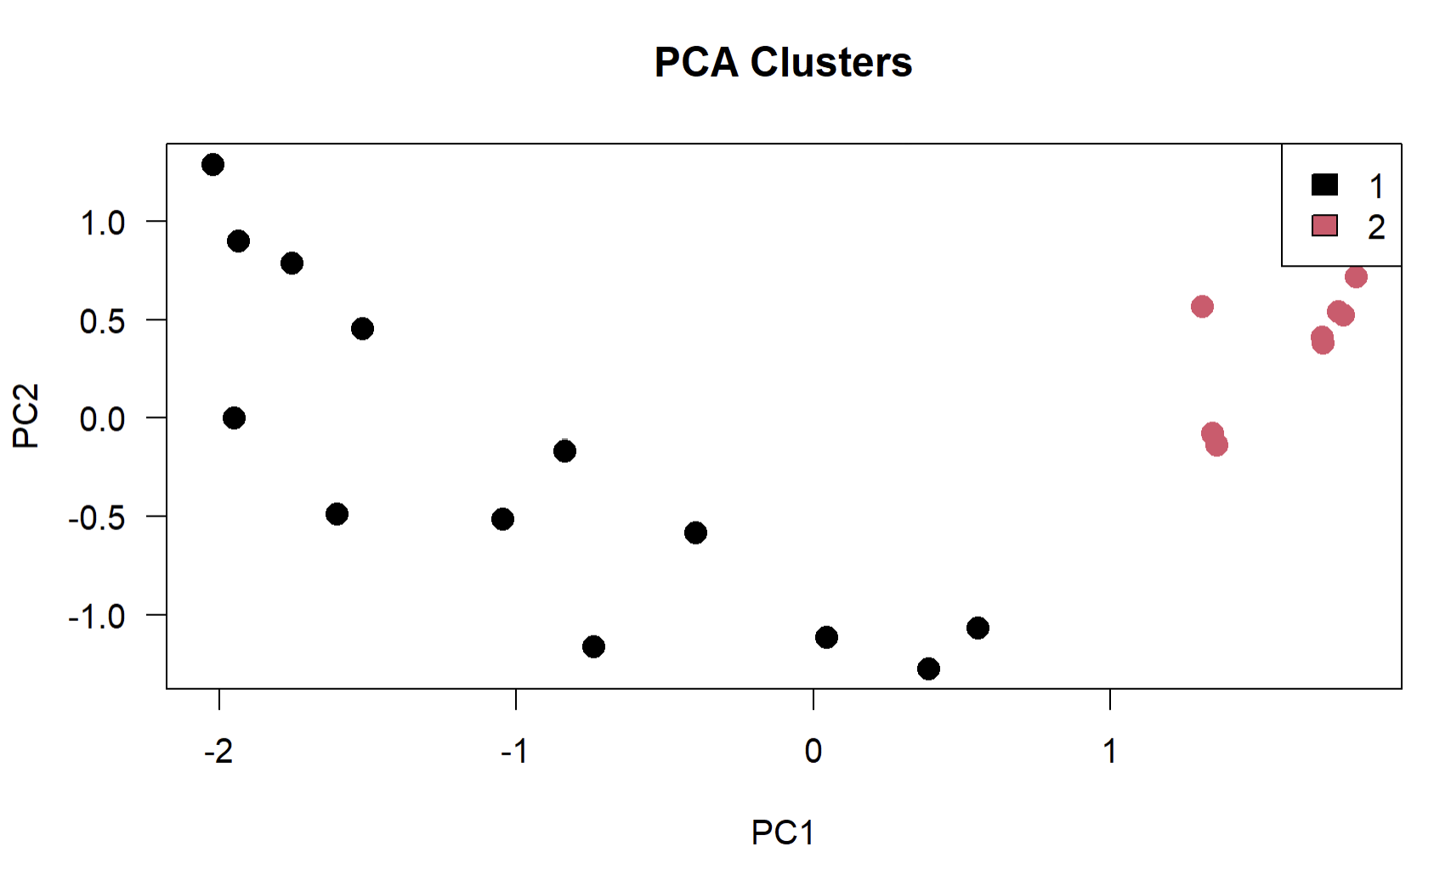
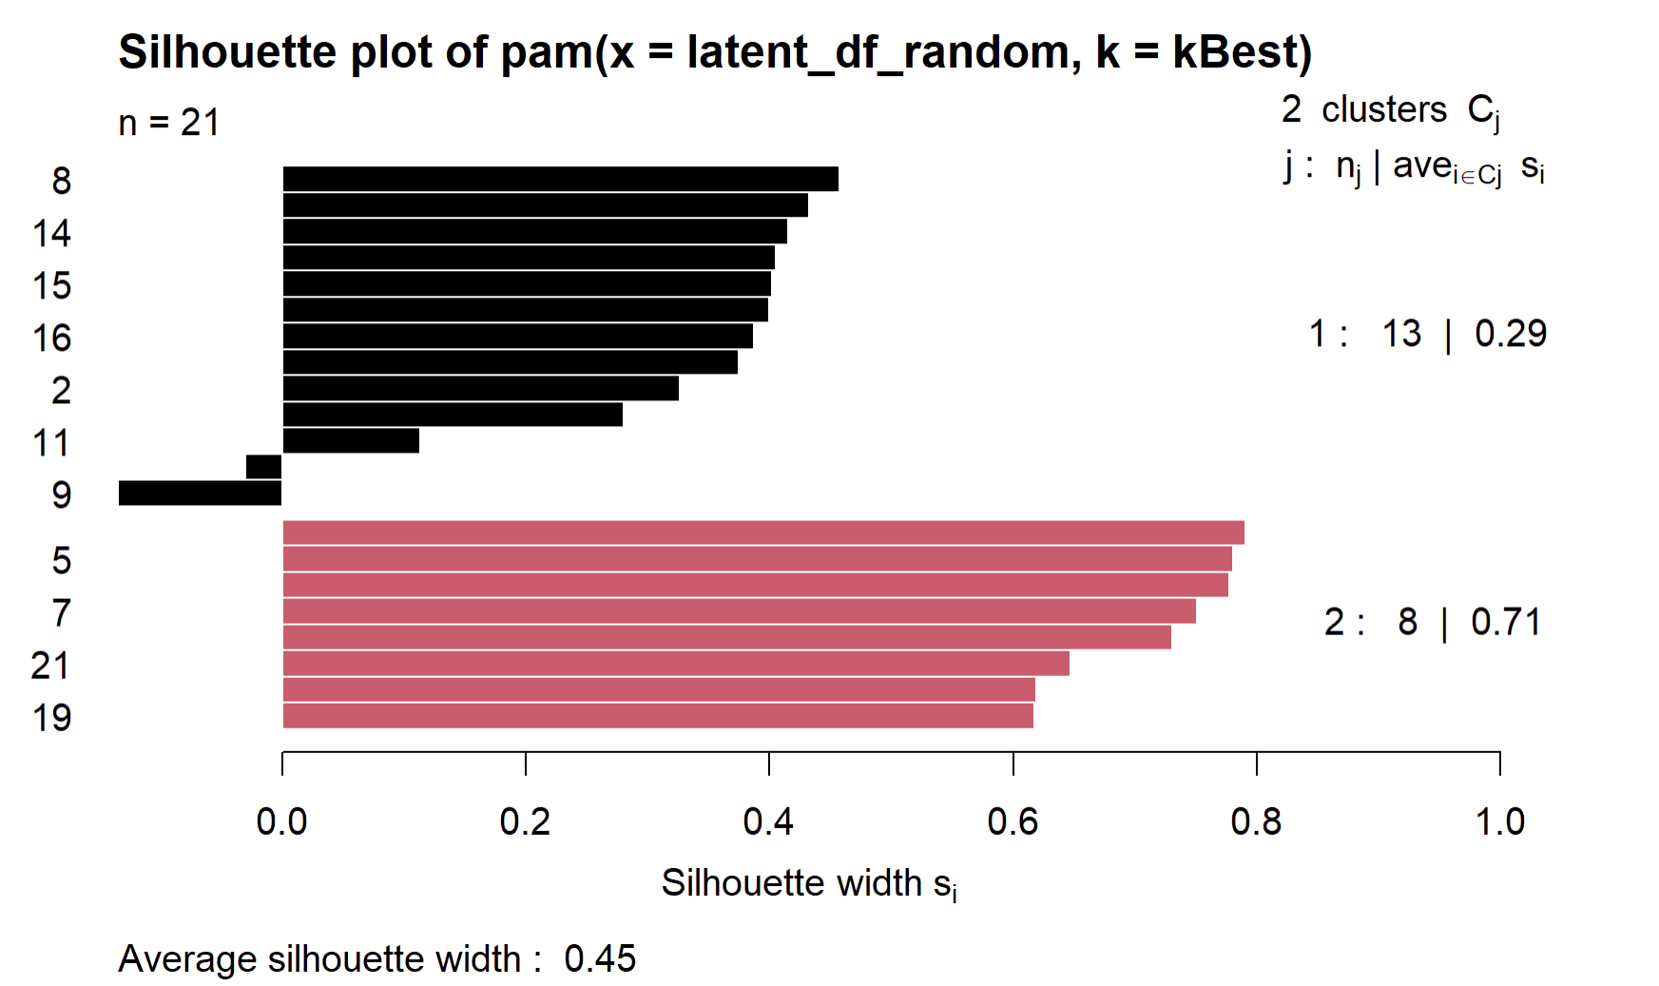
Clustering (Used 14 lifelines)

Slide 60
Working
- Interpretability of latent space (40 neurons vs. 48 original features)
see if plots are close (the plots of red vs. plots of black)
compare metabolites between red and black groups
- Run on larger set of lifelines (hpc)
- Variance explained vs. components plot
-

Slide 61
Interpretability
Meeting 11 – Feb 21, 2024

Slide 62
Clarity on Independence of Lifelines
Yes each lifeline is independent
Each timestep is fed into the layers, after last timestep, the hidden state is passed to latent vector
Weights are shared throughout the network / batch processing
LSTM input: (batches, timesteps, features)
(101 lifelines, 38 timesteps, 48 features), 38 timesteps just for reducing run time for now
- > Latent Space: 101 x # neurons in latent space

Slide 63
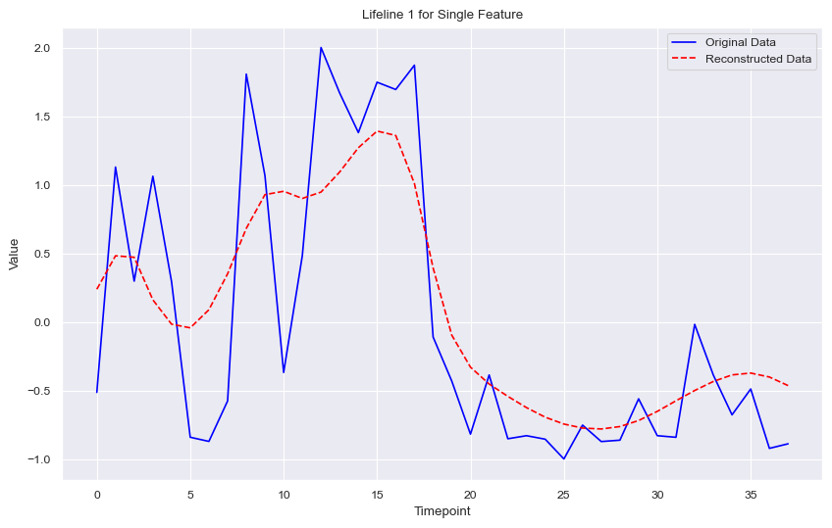
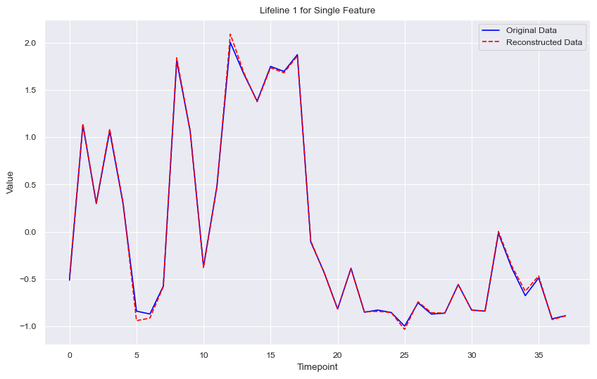
Clarity on Independence of Lifelines
Left latent vector for each lifeline, Right return_sequences=True, latent vector or EACH timestep in each lifeline

Slide 64
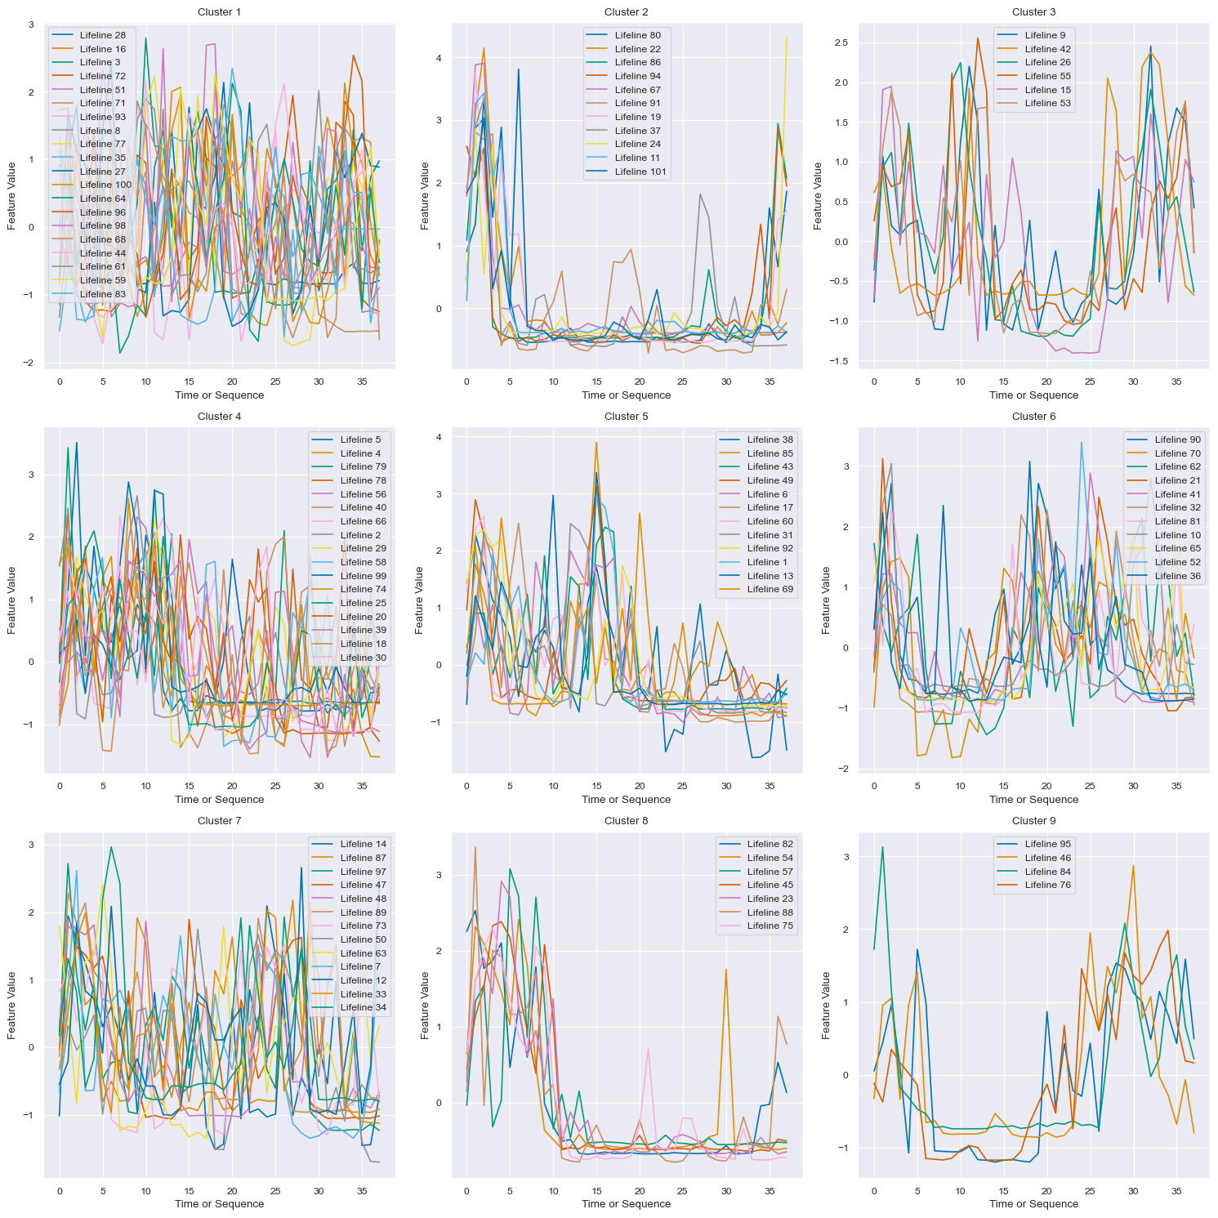
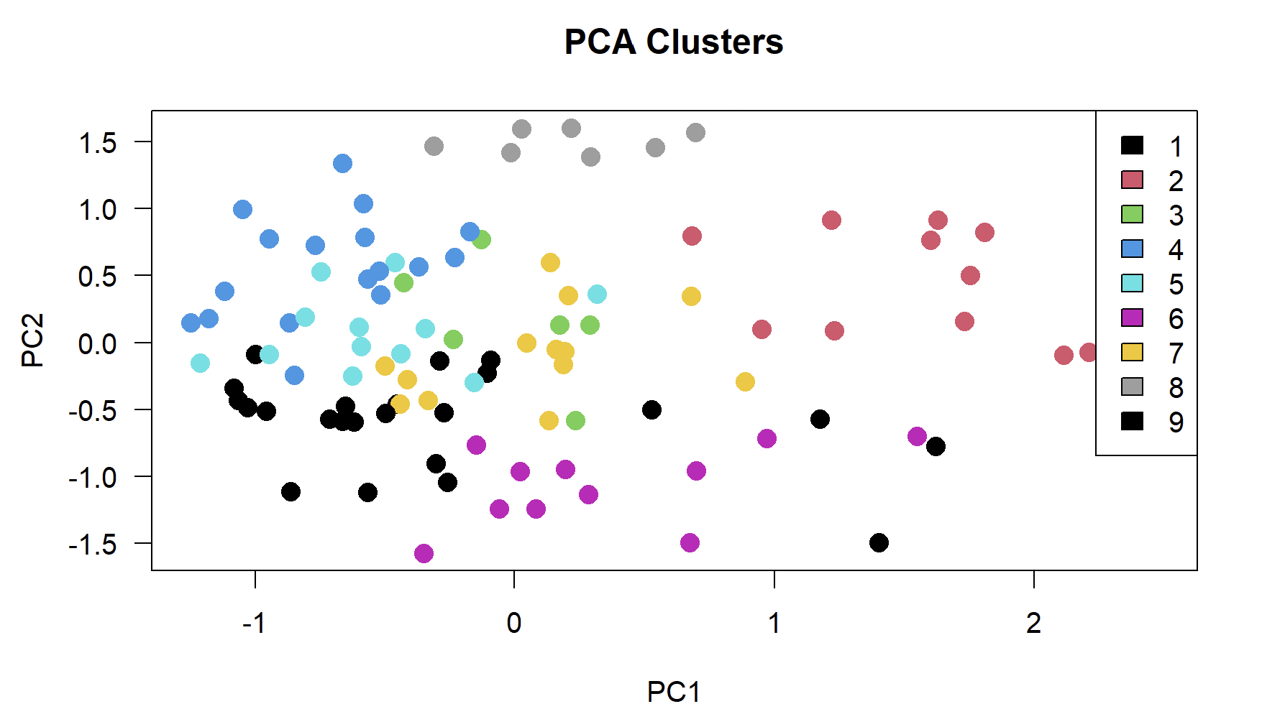
101 Lifelines, latent vector for each lifeline (just biomass reaction)

Slide 65
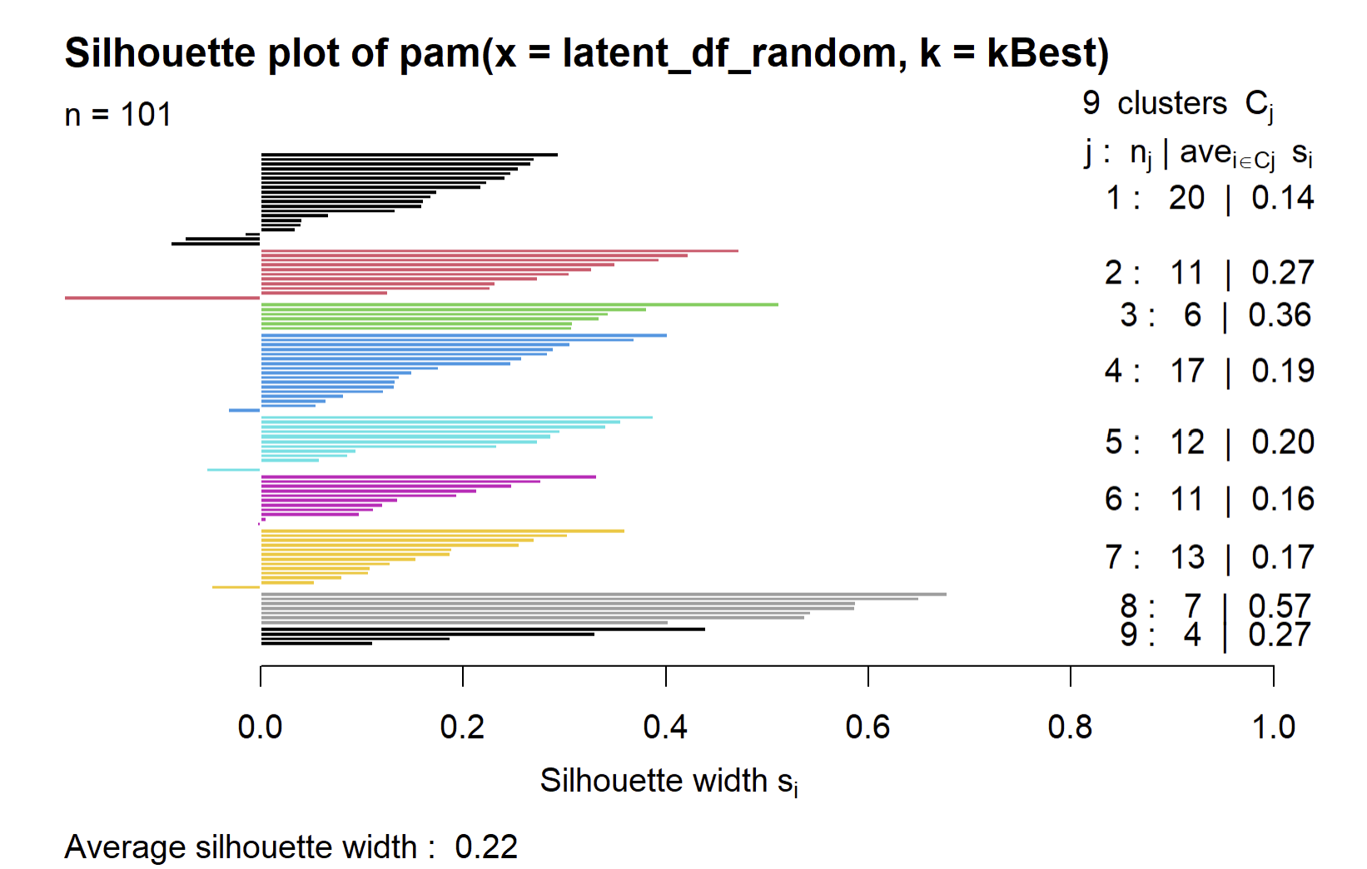
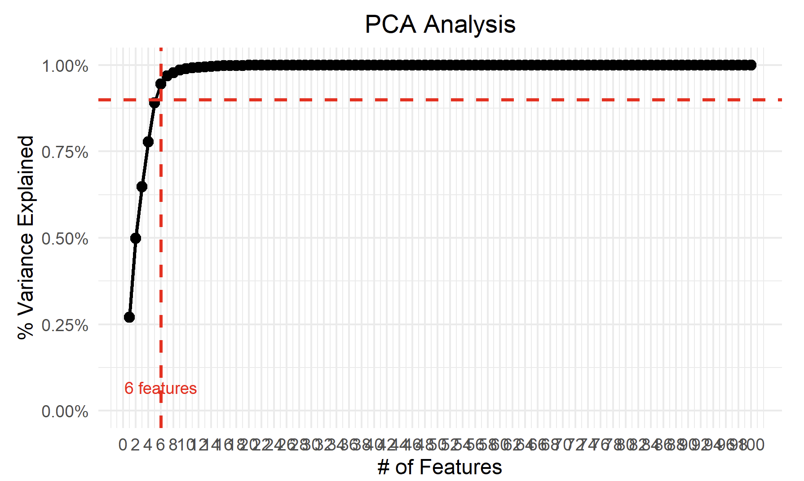
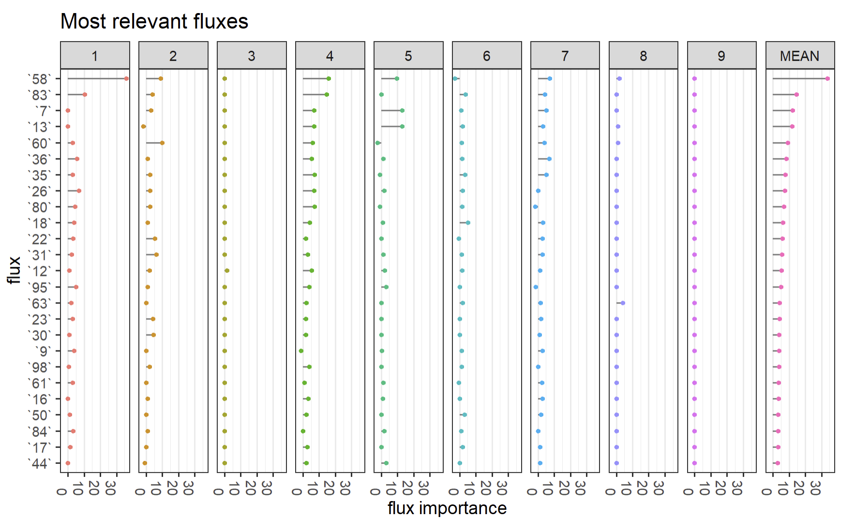
Clustering/ PCA

Slide 66
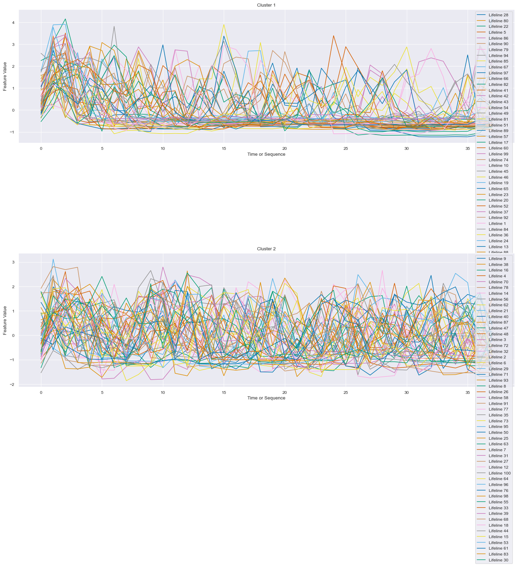
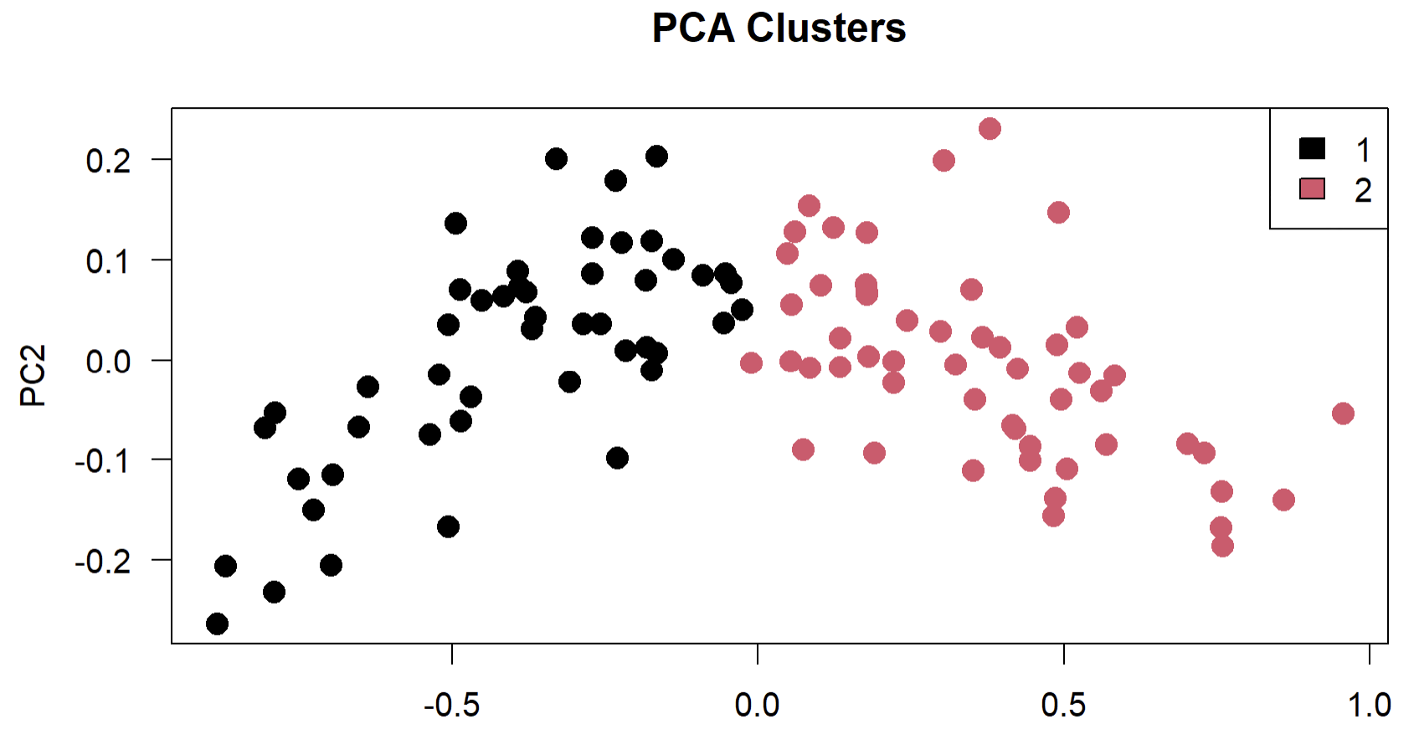
101 Lifelines, latent vector for each timestep in each lifeline (just biomass reaction)

Slide 67
101 Lifelines, latent vector for each timestep in each lifeline (just biomass reaction)

Slide 68
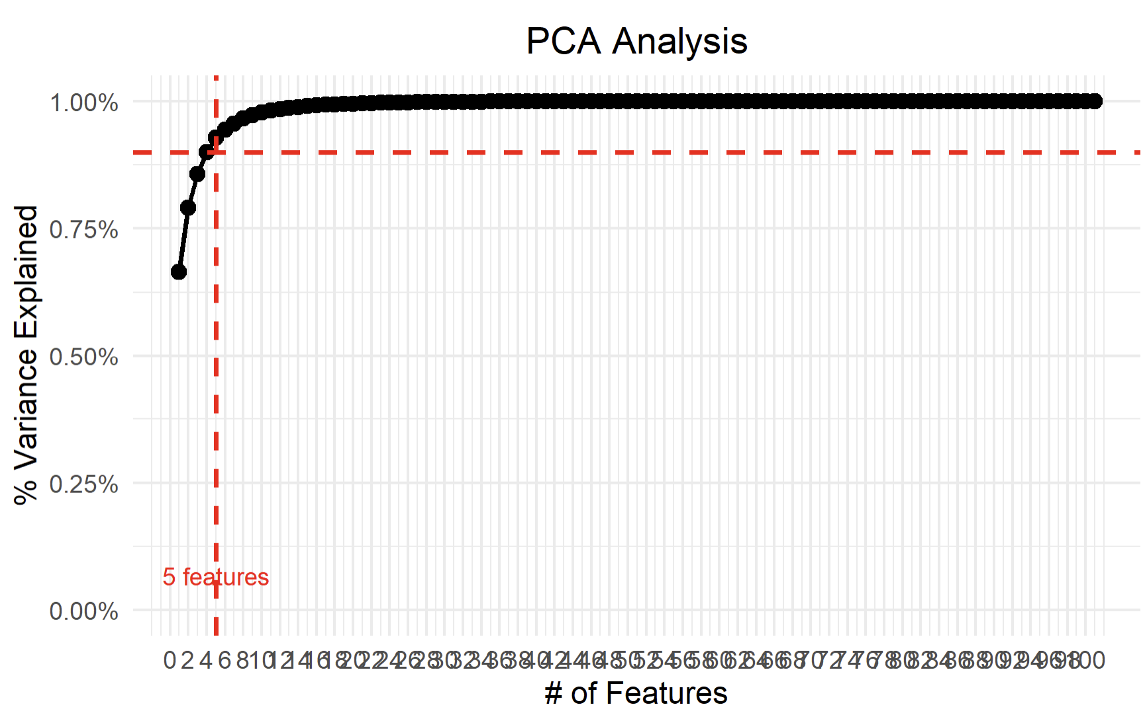
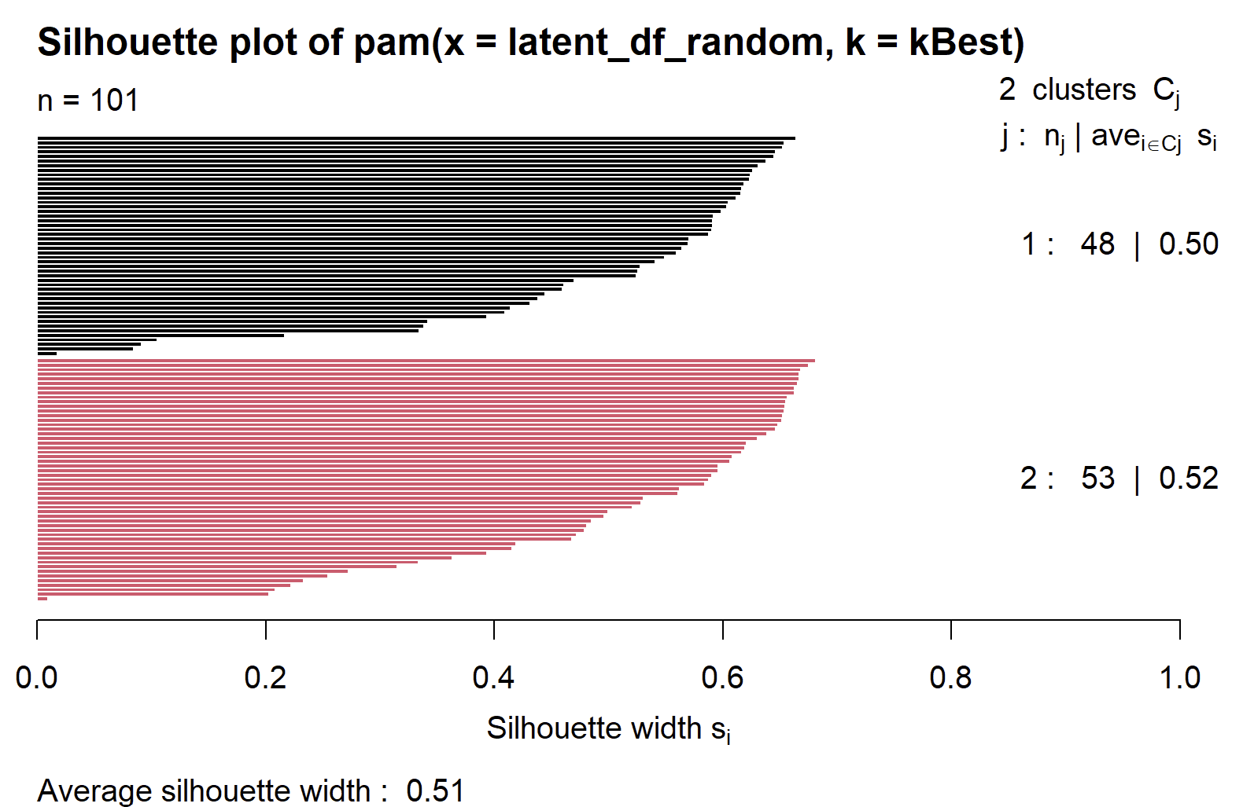
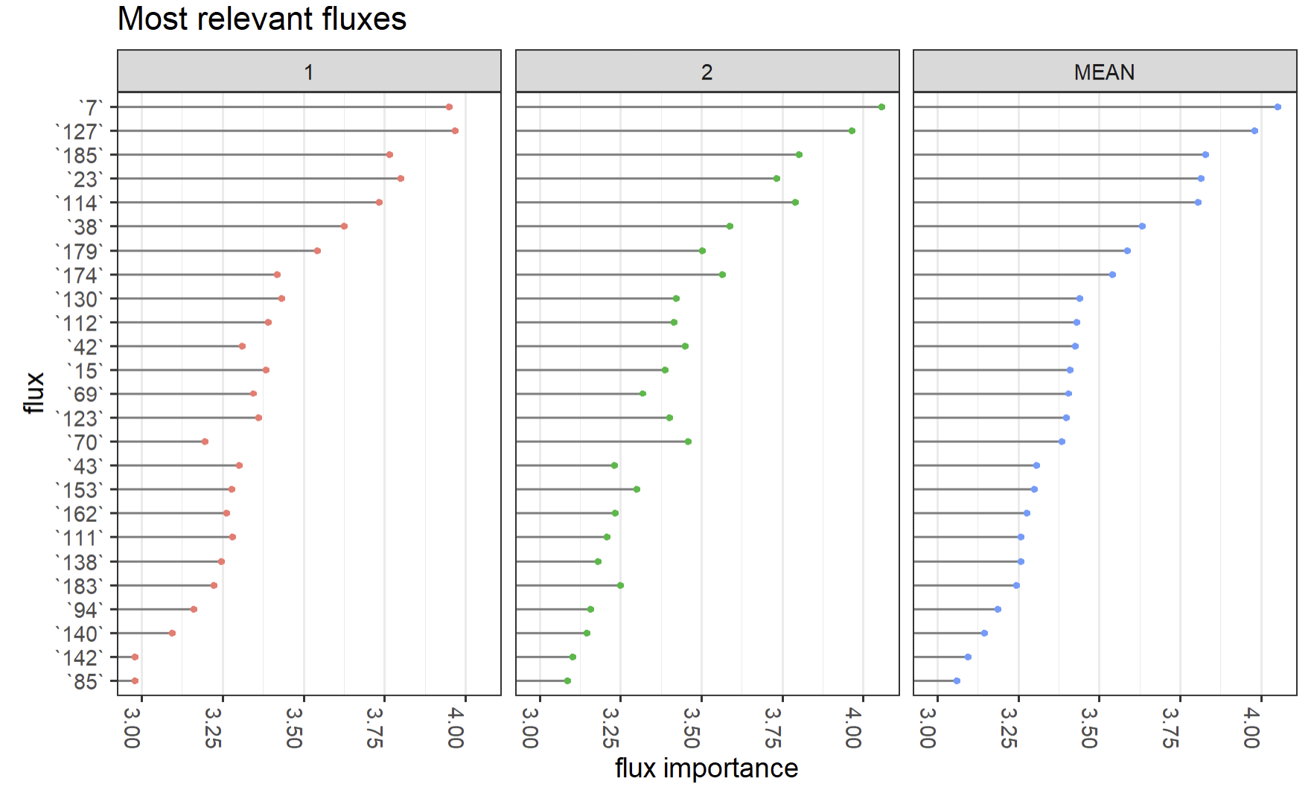
Clustering/ PCA

Slide 69
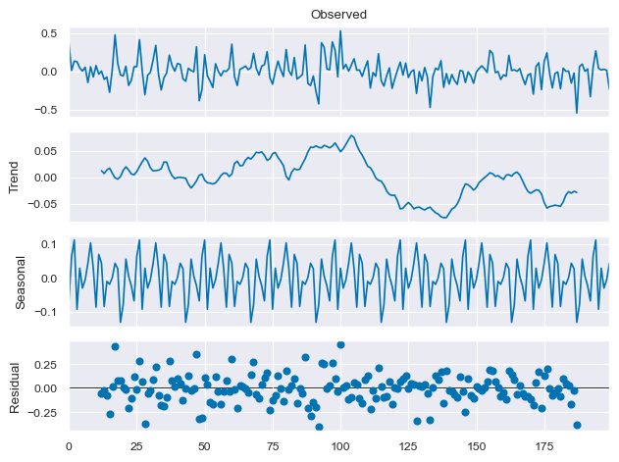
Working
Sensitivity analysis ? I could change something in latent space -> check what features are affected in reconstruction
Checking decoder weights (wrote code, but need to check results)
Now that I have latent space vector for each timestep of each lifeline
Time series decomposition / change point detection for trying to identify patterns WITHIN cell lifelines
Cplex / Lp solver
Goal within next month:
More clarity on results with toy model -> able to use
Geckpy / real model

Slide 70
Working
Sensitivity analysis ? I could change something in latent space -> check what features are affected in reconstruction
Checking decoder weights (wrote code, but need to check results)
Now that I have latent space vector for each timestep of each lifeline
Time series decomposition / change point detection for trying to identify patterns WITHIN cell lifelines

Slide 71
Interpretability
Meeting 12 – March 7, 2024

Slide 72
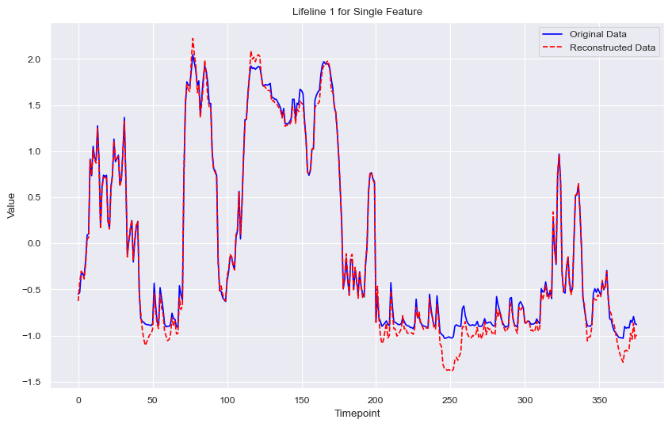
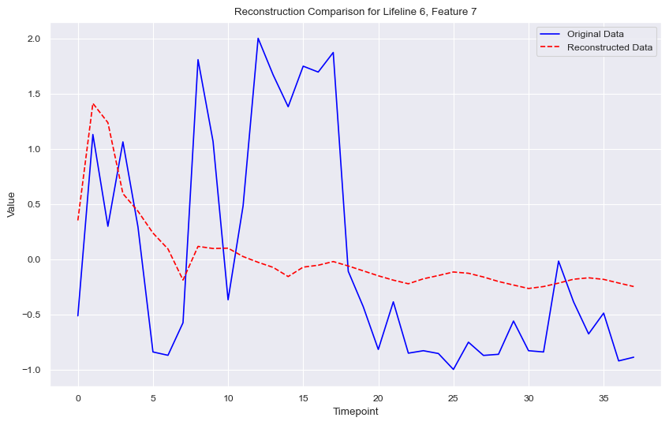
Autoencoder
80% reduction, probably could be more (arbitrarily choose 10 neurons)
Input (101 lifelines, 376 timesteps, 48 features) -> Latent Space (101, 376, 10 neurons)
Ran with more timesteps, also tested VAE but requires more computational power
What is the idea/purpose behind VAE ?
Normal AE
VAE
Not enough epochs/
Probably need bigger
Architecture too
More timesteps

Slide 73
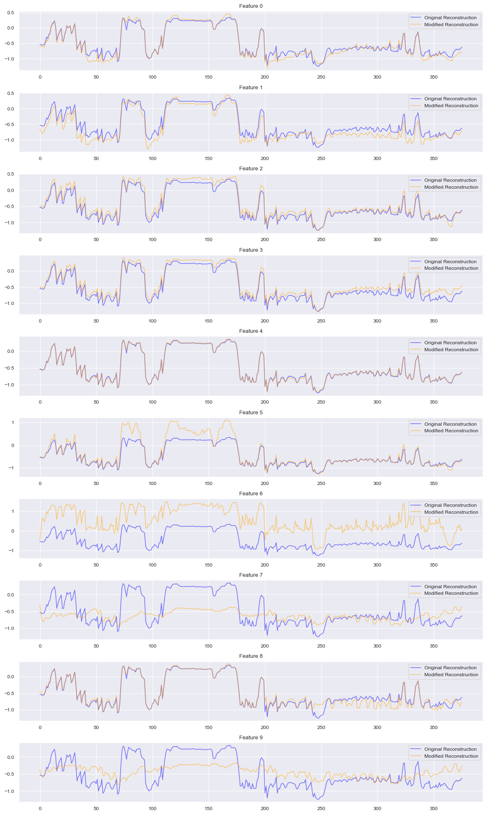
Sensitivity Analysis
Zero’d out each feature of latent space and reconstructed to see difference
Feature 5, 6, 7,9 ←→ Biomass

Slide 74


Clustering + Classification
Feature 5, 6, 7,9 ←→ Biomass
Some commonality
Still room for improvement
For k-means clustering I had aggregated timesteps (better way to do this?)
Sensitivity only on one lifeline – maybe overall shows similar most relevant fluxes to RF

Slide 75




DTW Clustering
Performed time series clustering (Dynamic Time Warping)
Results could be clearer but indicates something ?

Slide 76



Time Series Decomposition
Change point from cluster centroid (DTW clusters)
Plotted onto original lifelines ----------------->

Slide 77

Next
Continue to improve results/clustering and work on interpretability
- Can run on all other fluxes, better ways to aggregate timesteps for k-means, compare trend from time series decomposition instead, optimize autoencoder, use VAE etc.
Ran a lot of different graphs, spend more time analyzing + accumulating results

Slide 78

Data Science Conference June 10-12 CPH
Was considering submitting abstract for:

Slide 79
Interpretability
Meeting 12 – March 24, 2024

Slide 80

Parameter Tuning

Slide 81

Latent Space Interpretability
Heatmap of Discrepancies (Mean Squared Error between Original Data and Modified Reconstruction - Threshold)
Also implies less neurons needed in Latent Space
SHAP (visualizations?)
Feature importance

Slide 82

(DTW) Clustering Lifelines

Slide 83

(DTW) Clustering Lifelines

Slide 84

Working
Continue to improve results/clustering and work on interpretability
use VAE ran with 1000 epochs still learning really slow -> run on HPC
optimize autoencoder -> done
perturbation analysis on all features + visualization -> done
time series decomp/cross correlation trends -> working
real dataset from Victor ?
Prep:
GPU
Prepare scripts (normal, VAE, k means cluster, DTW cluster), scripts for github

Slide 85
Project Structure
Project Structure
/src: Contains all Python modules.
/data: Functions for data loading, preprocessing.
/models: Definitions of models.
/training: Training loops, callbacks.
/analysis: For analysis, like latent space perturbation and SHAP values.
/configs: YAML or JSON files for different configurations.
/scripts: Python scripts for running specific tasks.
/notebooks: Jupyter notebooks for experimentation and visualization.
/data: Folder for raw and processed data.

Slide 86
SHAP, Feature Importance
Meeting 13 – April, 2024

Slide 87
SHAP for Feature Importance
Heatmap of Discrepancies (Mean Squared Error between Original Data and Modified Reconstruction - Threshold)
Also implies less neurons needed in Latent Space
SHAP (visualizations)
Feature importance

Slide 89
Notes: Interpretation
Interpreting the results of clustering and classification after dimensionality reduction, especially when using techniques like autoencoders, can indeed be challenging. The primary issue is that the latent space representations are often not directly interpretable in terms of the original features. However, there are several strategies you can use to gain more insight:
Feature Mapping: Map the important features in the latent space back to the original feature space. This can be done by examining the weights of the autoencoder's encoder part. High weights indicate which original features are most influential in determining the values of the latent space features.
Reconstruction Analysis: Use the decoder part of the autoencoder to reconstruct the data points from the latent space back into the original feature space. Then, analyze these reconstructed points to see which original features vary the most across different clusters.
Latent Space Visualization: Visualize the latent space using techniques like t-SNE or UMAP. This can give you a sense of how the data is organized in the reduced dimensionality and how clusters are formed.
Correlation Analysis: Perform a correlation analysis between the latent features and the original features. This can help identify which original features are most strongly associated with the latent features.
Prototype Analysis: For each cluster, find the most representative data point (the medoid, in the case of k-medoids clustering). Then, use the decoder part of the autoencoder to map these points back to the original feature space. Analyzing these representative points can give insights into what characterizes each cluster.
Supplement with Domain Knowledge: If you have domain knowledge or external data sources, use them to interpret the clusters. For instance, if you know certain reactions or fluxes are related, see if these relationships are reflected in the clustering.
Sensitivity Analysis: Perform a sensitivity analysis by slightly altering the values of the latent features and observing how the reconstructed features change. This can help identify which latent features are most important for specific original features.
Cluster Characterization: Beyond just looking at the most relevant features, try to characterize each cluster in terms of its overall profile in the original feature space. This might involve looking at average values of original features for each cluster or identifying features where clusters differ significantly.
Integration with Other Data: If possible, integrate other relevant data sources to help interpret the clusters. For example, if you're working with biological data, integrating gene expression or pathway information might provide additional context.
Iterative Approach: Finally, consider an iterative approach where you adjust your dimensionality reduction or clustering methodology based on your findings and interpretations, aiming to improve the interpretability while maintaining the integrity of the data representation.
Remember, the goal of using an autoencoder for dimensionality reduction is to capture the most important variance in the data in a lower-dimensional space. The challenge is to link this variance back to meaningful interpretations in the original data space.

Slide 90

Working – 14 lifelines in Clustering + Random Forest
Issues:
Reasonable amount of clusters
Interpretation ?

Slide 91
Feature Selection
Dimension reduction using PCA (large-scale PCA)
Explained variance, and scree plot
Loadings and Biplot
Extracting the most informative features
Outlier detection

Slide 92
Dynamic simulations of microbial communities under perturbations: opportunities for microbiome engineering
Data Preprocessing: Before clustering the fluxes, the researchers perform preprocessing steps to filter out irrelevant reactions. They select a subset of equidistant time points from the time-series data. Reactions with constant values over time are removed. They also eliminate transport and exchange reactions, focusing on reactions within the inner metabolism. Additionally, redundant reactions are removed, keeping only one representative for coupled reactions.
Clustering: The metabolic reactions, based on their flux values over time and samples, are grouped using unsupervised machine learning techniques, specifically clustering algorithms. The paper refers to criteria from a previous study to determine the optimal number of clusters.
Random Forest Classifier: The flux-states resulting from clustering are used as labels for a Random Forest classifier. Random forests are an ensemble learning method that consists of multiple decision trees. In this case, the classifier is trained to predict the flux-state labels based on the reactions. This allows the researchers to identify which reactions contribute the most to differentiating between the flux-states.
Feature Importance: The feature importance of the reactions is computed using the Mean Decrease in Accuracy (MDA) metric. This metric measures the importance of each reaction in the random forest classifier for accurately predicting the flux-states. By analyzing the feature importance, the researchers can identify the reactions that have the most significant impact on distinguishing different flux-states.

Slide 93
Preserving interpretability while using PCA
Feature Selection: Instead of relying solely on PCA for dimensionality reduction, you can perform feature selection techniques specifically tailored for your task. These techniques aim to identify the most informative and relevant reactions for clustering and analysis. Some popular feature selection methods include mutual information, L1 regularization (Lasso), recursive feature elimination, or variance thresholding. By selecting a subset of important reactions, you can retain the interpretability of the original metabolic reactions without relying on a latent space representation.
Interpretability-Aware Dimensionality Reduction: Explore alternative dimensionality reduction techniques that prioritize interpretability while reducing the feature space. For example, methods like Non-negative Matrix Factorization (NMF) or Sparse Principal Component Analysis (Sparse PCA) can provide reduced-dimensional representations while still allowing for interpretation in terms of the original metabolic reactions.
Integration of PCA with Feature Importance: If PCA is used as a preliminary step, you can combine it with the analysis of feature importance obtained from the subsequent random forest classifier. After applying PCA, you can use the reduced-dimensional representation as input to the random forest classifier. The feature importance analysis can then be performed on the original metabolic reactions rather than the PCA-transformed features. This way, you can identify the important reactions in the context of the original representation while still benefiting from the dimensionality reduction provided by PCA.
Domain Expertise and Biologically Driven Filtering: Consider incorporating domain expertise and biological knowledge to guide the preprocessing steps. For instance, you can apply additional filtering criteria based on known biochemical pathways, functional categories of reactions, or other relevant biological constraints. By leveraging domain expertise, you can refine the filtering process and focus on reactions that are biologically meaningful for your specific analysis.

Slide 94
Alternatives
While the approach mentioned in the paper, combining clustering and random forests, can be effective for identifying relevant reactions, there are situations where alternative methods may be preferred. Here are a few reasons why you might consider using other techniques over clustering and random forests:
Interpretability: Clustering alone may not provide explicit insights into the importance or contribution of individual reactions. It can group similar flux profiles together but might not reveal the specific reactions that drive the differences between clusters. Random forests help in identifying important features, but the interpretation might be limited to the context of the classifier. Other techniques like feature selection or dimensionality reduction methods with interpretability objectives can provide clearer insights into the specific reactions and their relevance.
Dimensionality Reduction: If the dataset has a high number of features (e.g., hundreds or thousands of reactions), dimensionality reduction techniques like PCA, NMF, or Sparse PCA can be useful. These methods capture the essential information in a reduced-dimensional space while maintaining interpretability. By reducing the dimensionality, you can potentially mitigate issues related to the curse of dimensionality, improve computational efficiency, and focus on the most informative features.
Alternative Machine Learning Algorithms: While random forests are widely used and offer good performance, it's worth exploring other machine learning algorithms as well. For example, support vector machines (SVM), gradient boosting, or deep learning techniques like neural networks may be suitable for the specific task of identifying relevant reactions. Different algorithms have varying strengths, and trying multiple methods can provide a comprehensive analysis and potentially better results for your specific dataset.
Combination of Techniques: It's not necessarily an "either-or" choice between clustering and random forests versus alternative techniques. Instead, a combination of approaches can be beneficial. For example, you can use clustering to identify initial groups or patterns in the data, then apply other techniques like dimensionality reduction or feature selection within each cluster to identify important reactions. This hybrid approach can leverage the strengths of different methods and provide a more comprehensive analysis.
Ultimately, the choice of techniques depends on the specific goals, characteristics of the data, and the interpretability requirements of your analysis. Exploring various options, combining methods, and considering the context of the problem can help you choose the most suitable techniques for your particular research or application.

Slide 95
Analyzing Loadings
When the loadings in PCA are relatively close in magnitude, it suggests that multiple features (reactions in this case) contribute similarly to the corresponding principal component. In such situations, it can be challenging to distinguish the most important reactions solely based on the absolute values of the loadings.
To handle cases where the loadings are close, you can consider the following approaches:
Look for Consistency: Examine the loadings across multiple principal components. If a particular reaction consistently exhibits high loadings across multiple components, it indicates its importance in explaining the underlying variability in the dataset.
Consider Cumulative Explained Variance: Assess the cumulative explained variance ratio associated with each principal component. If a component contributes significantly to the cumulative explained variance, the reactions with relatively higher loadings in that component may be considered more important.
Analyze Patterns and Relationships: Instead of solely relying on the magnitude of loadings, examine the patterns and relationships among the loadings of different reactions. Look for groups of reactions with similar loadings, as they may collectively represent an important metabolic pathway or functional module.
Combine with Domain Knowledge: Incorporate prior domain knowledge, biological context, or existing literature to guide the interpretation of the loadings. Some reactions may have known functional significance or strong associations with the research problem, which can help prioritize their importance.
Perform Sensitivity Analysis: Explore the impact of varying the number of principal components used in the analysis. By including additional components, you may uncover subtle differences in the loadings that can help differentiate the importance of closely related reactions.
Remember that PCA is just one method for dimensionality reduction and feature analysis. If the closeness of loadings poses challenges in your analysis, you can consider alternative techniques such as sparse PCA, non-negative matrix factorization (NMF), or feature selection methods to further explore the importance of reactions in your research problem.

Slide 96
Cell Lifelines
If your cell lifelines data has thousands of time points but only 4 columns (x, y, z, and substrate concentration), it means that you have high-dimensional data with a large number of observations. In this case, using PCA with 4 components will not be suitable for dimensionality reduction because you are already using all the available columns.
PCA is primarily used to reduce the dimensionality of data by capturing the most significant variations in the dataset. If you want to reduce the number of rows (observations) while retaining the 4 columns, you can consider alternative techniques such as sampling or filtering methods.
Here are a couple of approaches you can consider:
Sampling: If the number of time points is too large and you want to reduce the dataset while preserving the overall distribution of the data, you can use random sampling techniques. Randomly select a subset of time points from the dataset that adequately represents the overall behavior. This will reduce the number of rows while retaining the original columns.
Filtering: If there are specific criteria or patterns you want to consider for selecting time points, you can apply filtering techniques. For example, you can filter out time points that fall within a certain range or meet specific conditions based on the substrate concentration or other relevant factors.
Both sampling and filtering methods can help you reduce the number of rows in your dataset while retaining the original columns of interest (x, y, z, and substrate concentration). After reducing the dataset, you can then perform PCA or other analyses as needed.
Remember to consider the implications of reducing the dataset on the representativeness and generalizability of your results. It's important to ensure that the reduced dataset still captures the essential characteristics and patterns of the original data.

Slide 97
Autoencoders
Problem: Multidimensionality in sensor data requires summarization for easy clustering.
Technique: Custom autoencoder using Keras for dimensionality reduction.
Architecture: Encoder and decoder with Dense layers.
Data: 20 individuals, 3 positional series of movements (length 170).
Training: First 10 individuals used for training.
Evaluation: Reconstruction errors computed for remaining individuals.
Interpretation: Low errors indicate confident activity detection.
Benefits: Captures temporal dynamics and interactions between reactions.
Applicability: Suitable for temporal data with time series representations of reactions.

Slide 98
Predictive Modeling: Autoencoders can be extended to include additional layers beyond the decoder. By incorporating supervised learning techniques, such as adding classification or regression layers on top of the autoencoder architecture, the learned features can be used for predictive modeling tasks. The encoder captures meaningful representations of the cell lifeline data, which can aid in predicting specific outcomes or properties of interest.

Slide 99
Autoencoders & Metabolic Networks
Autoencoders can provide valuable insights into cell lifelines and metabolic networks by learning compact and meaningful representations of the underlying data. Here are some ways in which autoencoders can help us gain information about cell lifelines and metabolic networks:
Reconstruction of Cell Lifelines: Autoencoders are trained to reconstruct their input data from compressed latent representations. By training an autoencoder on cell lifeline data, the decoder part of the autoencoder can generate reconstructed lifelines that closely resemble the original input. Comparing the reconstructed lifelines with the original ones can help identify patterns, similarities, and differences. This can provide insights into the dynamics and variations within the lifelines and help uncover underlying regulatory mechanisms.
Feature Extraction: The encoder part of an autoencoder learns to extract the most salient features from the input data. In the context of cell lifelines, this can include identifying important metabolites, proteins, or gene expressions that contribute significantly to the observed variations. By analyzing the learned latent space, we can gain insights into the most informative features and their relationships, which can aid in understanding the underlying biology and metabolic processes.
Anomaly Detection: Autoencoders can be used to detect anomalies or deviations from normal cell lifelines. By training an autoencoder on a dataset of healthy or normal lifelines, it can learn to reconstruct normal patterns. When presented with anomalous lifelines, the autoencoder will have higher reconstruction errors, indicating a deviation from the normal behavior. This can help identify aberrations in metabolic networks or cell lifelines, which may indicate disease conditions, drug responses, or other important phenomena.
Pathway Reconstruction: Autoencoders can capture the hierarchical relationships and interactions within metabolic networks. By training an autoencoder on metabolic pathway data, it can learn to reconstruct the pathways and identify the key reactions and metabolites involved. This can provide insights into the functional relationships between reactions, the flow of metabolites, and the overall structure of the metabolic network.
Discovery of Novel Enzymatic Reactions: Autoencoders can be used to predict potential enzymatic reactions and uncover novel interactions within metabolic networks. By training an autoencoder on a comprehensive set of known enzymatic reactions, it can learn the underlying patterns and relationships. The decoder part of the autoencoder can then generate predictions of new enzymatic reactions based on the learned representations. These predictions can guide experimental investigations and contribute to the expansion and refinement of existing metabolic networks.
In summary, autoencoders offer valuable tools for analyzing cell lifelines and metabolic networks by extracting meaningful features, reconstructing patterns, detecting anomalies, and facilitating the discovery of novel interactions and reactions. These insights can advance our understanding of biological systems, disease mechanisms, and potential drug targets.

Slide 100
Notes
Increase the number of hidden units in the encoder and decoder layers: This can provide more capacity for the model to capture the patterns and features in the data.
Add more layers to the encoder and decoder: Increasing the depth of the model can help it learn more complex representations.
Experiment with different activation functions: Try different activation functions such as 'relu', 'tanh', or 'sigmoid' to see which works best for your data.
Increase the number of training epochs: Training the model for more epochs can allow it to converge to a better solution. However, be cautious not to overfit the data.
Adjust the learning rate: Experiment with different learning rates to find the optimal value for your model.
Normalize the input data: Normalizing the input data can help the model learn more effectively and improve reconstruction quality.

Slide 101
Comparing Models Notes
1. Highlight the Importance of Temporal Structure:
Begin by emphasizing that the time component is not just an added dimension but represents ordered, sequential data where temporal patterns, dependencies, and relationships are paramount.
You can demonstrate with simple visualizations or examples how critical events or patterns might be missed when the temporal structure is ignored.
2. Quantitative Comparison:
Conduct an experiment where you assess the performance of both methods on a held-out test set. This can be in terms of classification accuracy, recall, precision, F1-score, etc.
If the autoencoder + DTW + random forest method outperforms the simple clustering + random forest method, it serves as empirical evidence of its superiority.
3. Model Interpretability and Insight:
For time series data, using methods like DTW can provide more meaningful insights into the temporal dynamics of the series. Highlight instances where the temporal patterns captured by DTW might reveal meaningful dynamics about the data.
Autoencoders can capture intricate temporal patterns and structures in the data, especially if they are LSTM-based. This means they're retaining more critical information than a method that doesn't consider the temporal aspect.

Slide 102
Comparing Models Notes
4. Reconstruction and Anomaly Detection:
Show the reconstruction error of the autoencoder on the test set. If it's low, it means the autoencoder has captured the essential structures in the data.
Furthermore, autoencoders can be used for anomaly detection in time series data, a feature you can't achieve with simple clustering.
5. Visual Comparison:
Visualize clusters or classifications obtained from both methods. If clusters obtained after autoencoders and DTW make more intuitive sense or capture clearer patterns, it's a significant point in their favor.
6. Robustness and Generalization:
Test both methods across various scenarios or datasets. If the autoencoder-based method consistently outperforms or is more robust, it provides a compelling case for its adoption.
7. Literature and Precedence:
Cite studies or papers where similar time series data benefited from using advanced techniques like autoencoders or DTW. Showing that experts or the academic community leans towards a particular approach can be persuasive.
8. Potential Risks of Ignoring Temporal Structure:
Discuss potential implications or risks of not considering the temporal structure. For example, if you're working on medical time series data, missing a critical event sequence could have severe consequences.
Finally, communicate that while the method involving autoencoders, DTW, and random forests might be more computationally intensive or complex, the benefits in terms of accuracy, insight, and robustness more than compensate for these challenges.

